Slide 1
If you have not already downloaded and installed the Brigade fonts used in this presentation you can download our font pack at http://leaders.boys-brigade.org.uk/ourbrand.htm
Alternatively you may just need to check through the presentation to ensure the substitute font used is displaying correctly.

Slide 2


Slide 3

HOW WILL THE SESSION WORK?
Welcome (5 mins)
Ice Breakers (10 mins)
Opening Devotions - Biblical Leaders (10 mins)
Leadership Matters (20 mins) – Who’s Who
Leadership in BB (40 mins) - including Break
Practicalities of Leadership (25 mins)
Finish & Log off (5mins)

Slide 4
TODAY’S OBJECTIVES
Consider the different qualities of leadership and what makes a good leader.
Understand the different knowledge, skills and attitudes that make up a leader.
Think about the different considerations a leader needs to think about when running activities.
To develop and share new activities and ideas for working with children
Tick off an important requirement for the King’s badge (preparing for your volunteering in the BB)
Meet and get to know other young people from different groups
Have fun!

Slide 5
GETTING INTO OUR GROUPS
We are going to form some smaller groups that we will go in and out of during today’s session.

Slide 6
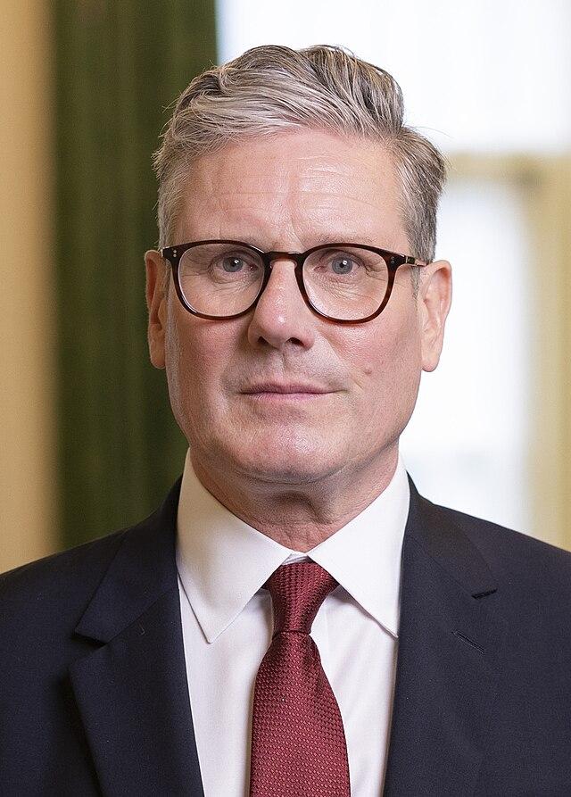
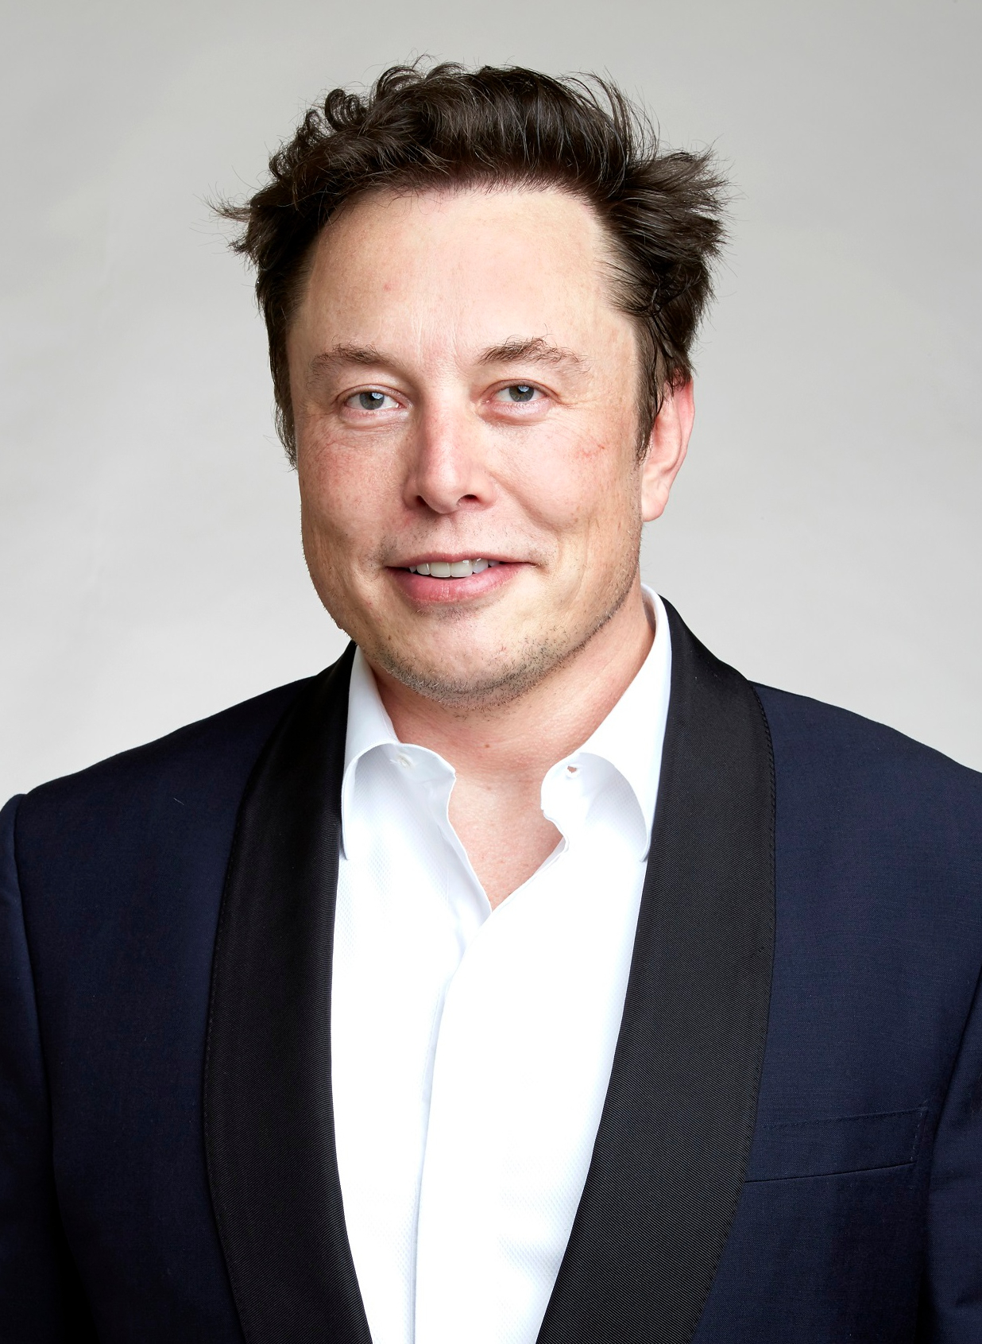
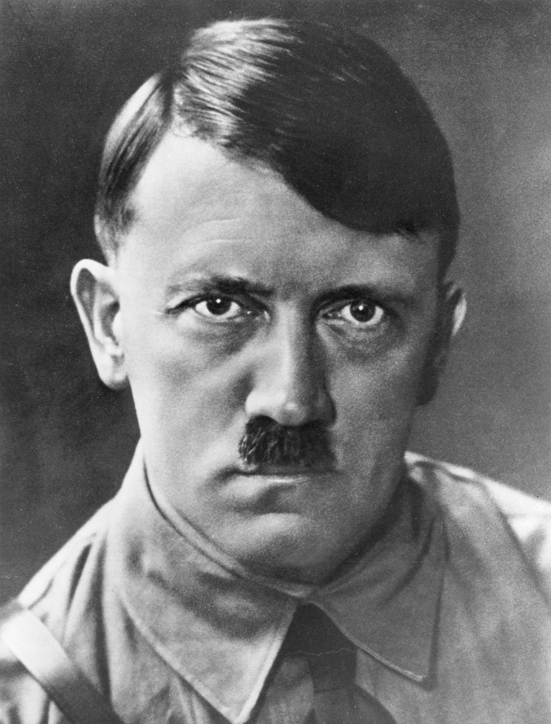
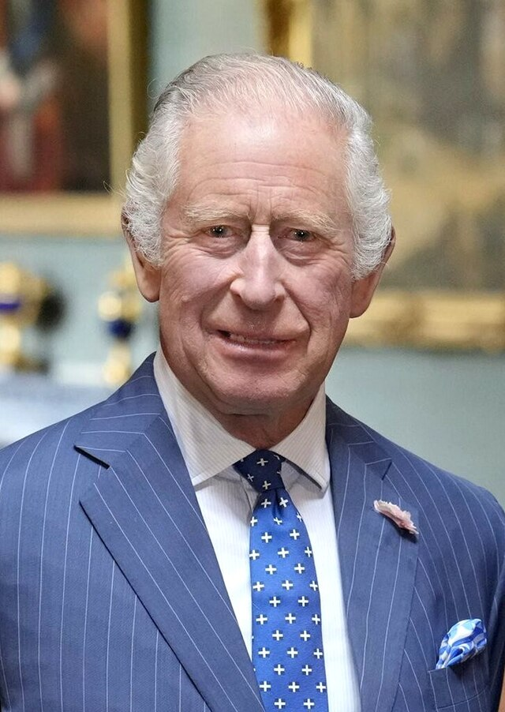

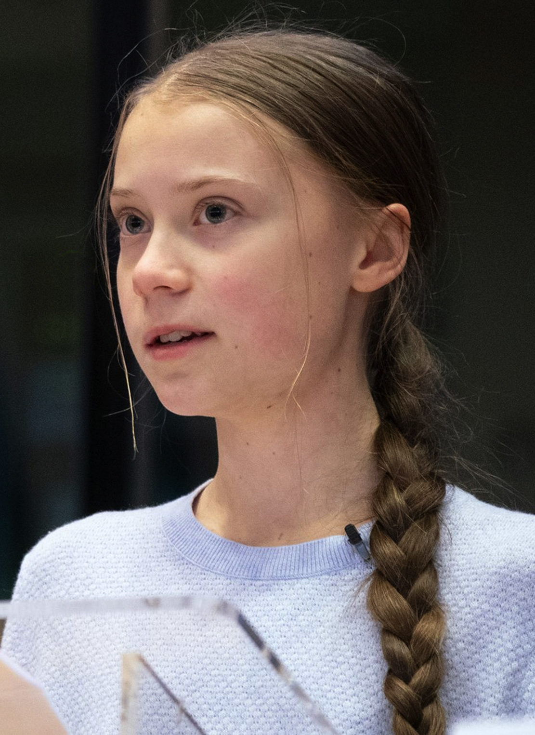
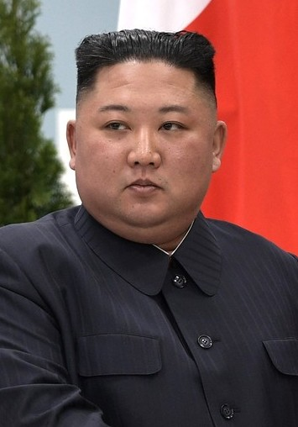
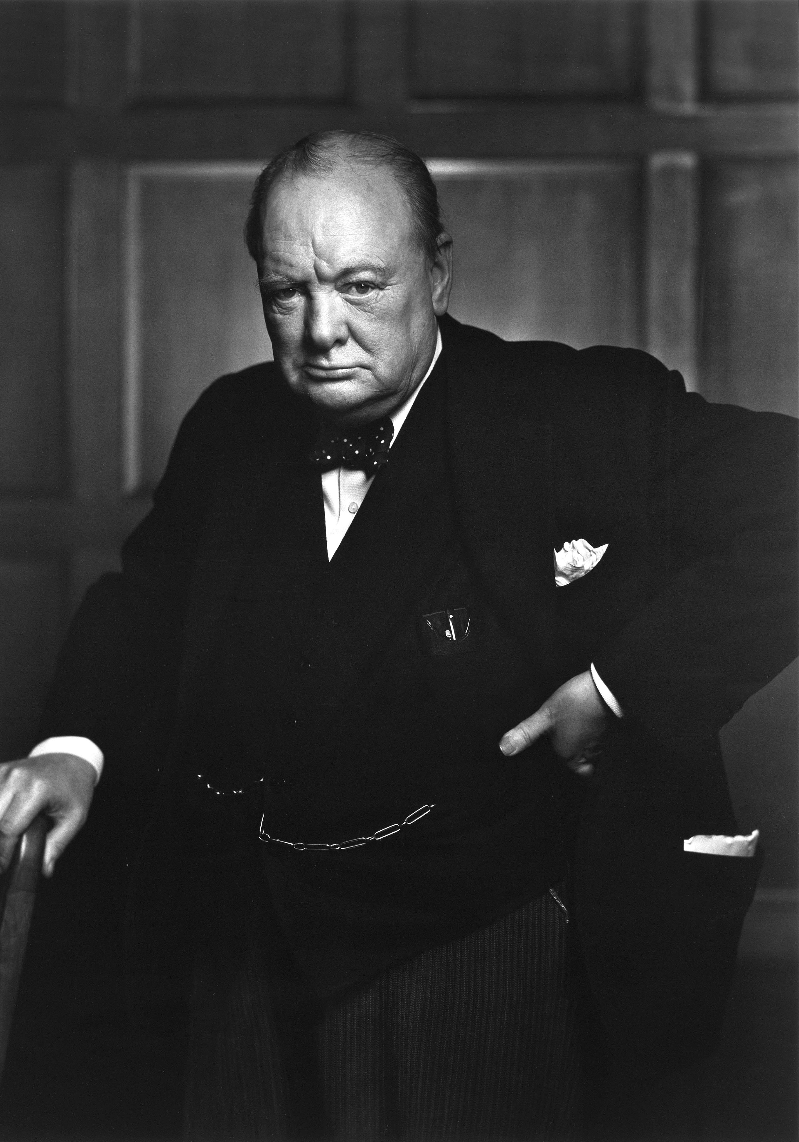
LEADERSHIP MATTERS: WHO’S WHO
A look at well-known leaders and what makes them a ‘good’ or ‘bad’ leader.

Slide 8
LEADERSHIP IN BB: AGREEMENT LINE
An activity that looks at different opinions of leadership in the BB and encourages debates between participants, exploring different viewpoints.

Slide 9
LEADERSHIP IN BB: ACTIVITIES & LEADERS
To take a look at two of the most important aspects of BB – activities and leaders. Participants will explore what makes for a good leader and a good activity and why both are important.

Slide 10
WHAT MAKES A GOOD LEADER?
Knowledge / Skills / Attitudes

Slide 11
WHAT MAKES A GOOD ACTIVITY?

Slide 12
LEADERSHIP IN BB: ACTIVITIES & LEADERS
So, what’s more important . . .
Activities or Leaders?

Slide 13
LEADERSHIP IN BB: JOB ADVERT
To continue thinking about what makes a good BB leader by creating a job advert, designed to find the perfect leader. What should be included in the person specification?

Slide 14
JOB ADVERT

Slide 15
BENEFITS
& WHY?

Slide 16
PRACTICALITIES OF LEADERSHIP:
RUNNING AN ACTIVITY
To think about the practicalities of leadership and running BB activities. Preparing young people for the leadership role they will be taking on and help to give them confidence to take an activity back to their BB Company and run it with the age group they are working with.

Slide 17
YOUR ACTIVITY
What you need to consider in planning and running this activity

Slide 18
PRACTICALITIES OF LEADERSHIP:
CHALLENGE
You are encouraged to take back your idea back to your Company or come up with something else and speak to your Captain/ Leader in Charge about taking responsibility for running an activity.

Slide 19
RECAP ON TODAY’S OBJECTIVES
Consider the different qualities of leadership and what makes a good leader.
Understand the different knowledge, skills and attitudes that make up a leader.
Think about the different considerations a leader needs to think about when running activities.
To develop and share new activities and ideas for working with children
Tick off an important requirement for the King’s badge (preparing for your volunteering in the BB)
Meet and get to know other young people from different groups
Have fun!

