Slide 1
If you have not already downloaded and installed the Brigade fonts used in this presentation you can download our font pack at http://leaders.boys-brigade.org.uk/ourbrand.htm
Alternatively you may just need to check through the presentation to ensure the substitute font used is displaying correctly.

Slide 2


Slide 3

OUR OBJECTIVES
Reflect on your life experiences up to this point.
Think about the journey working towards the King’s Badge has taken you on.
Start to explore what you want from the future
Tick off the final requirement for the King’s badge
Meet and hear from other young people in a similar position to you
Have fun!

Slide 5
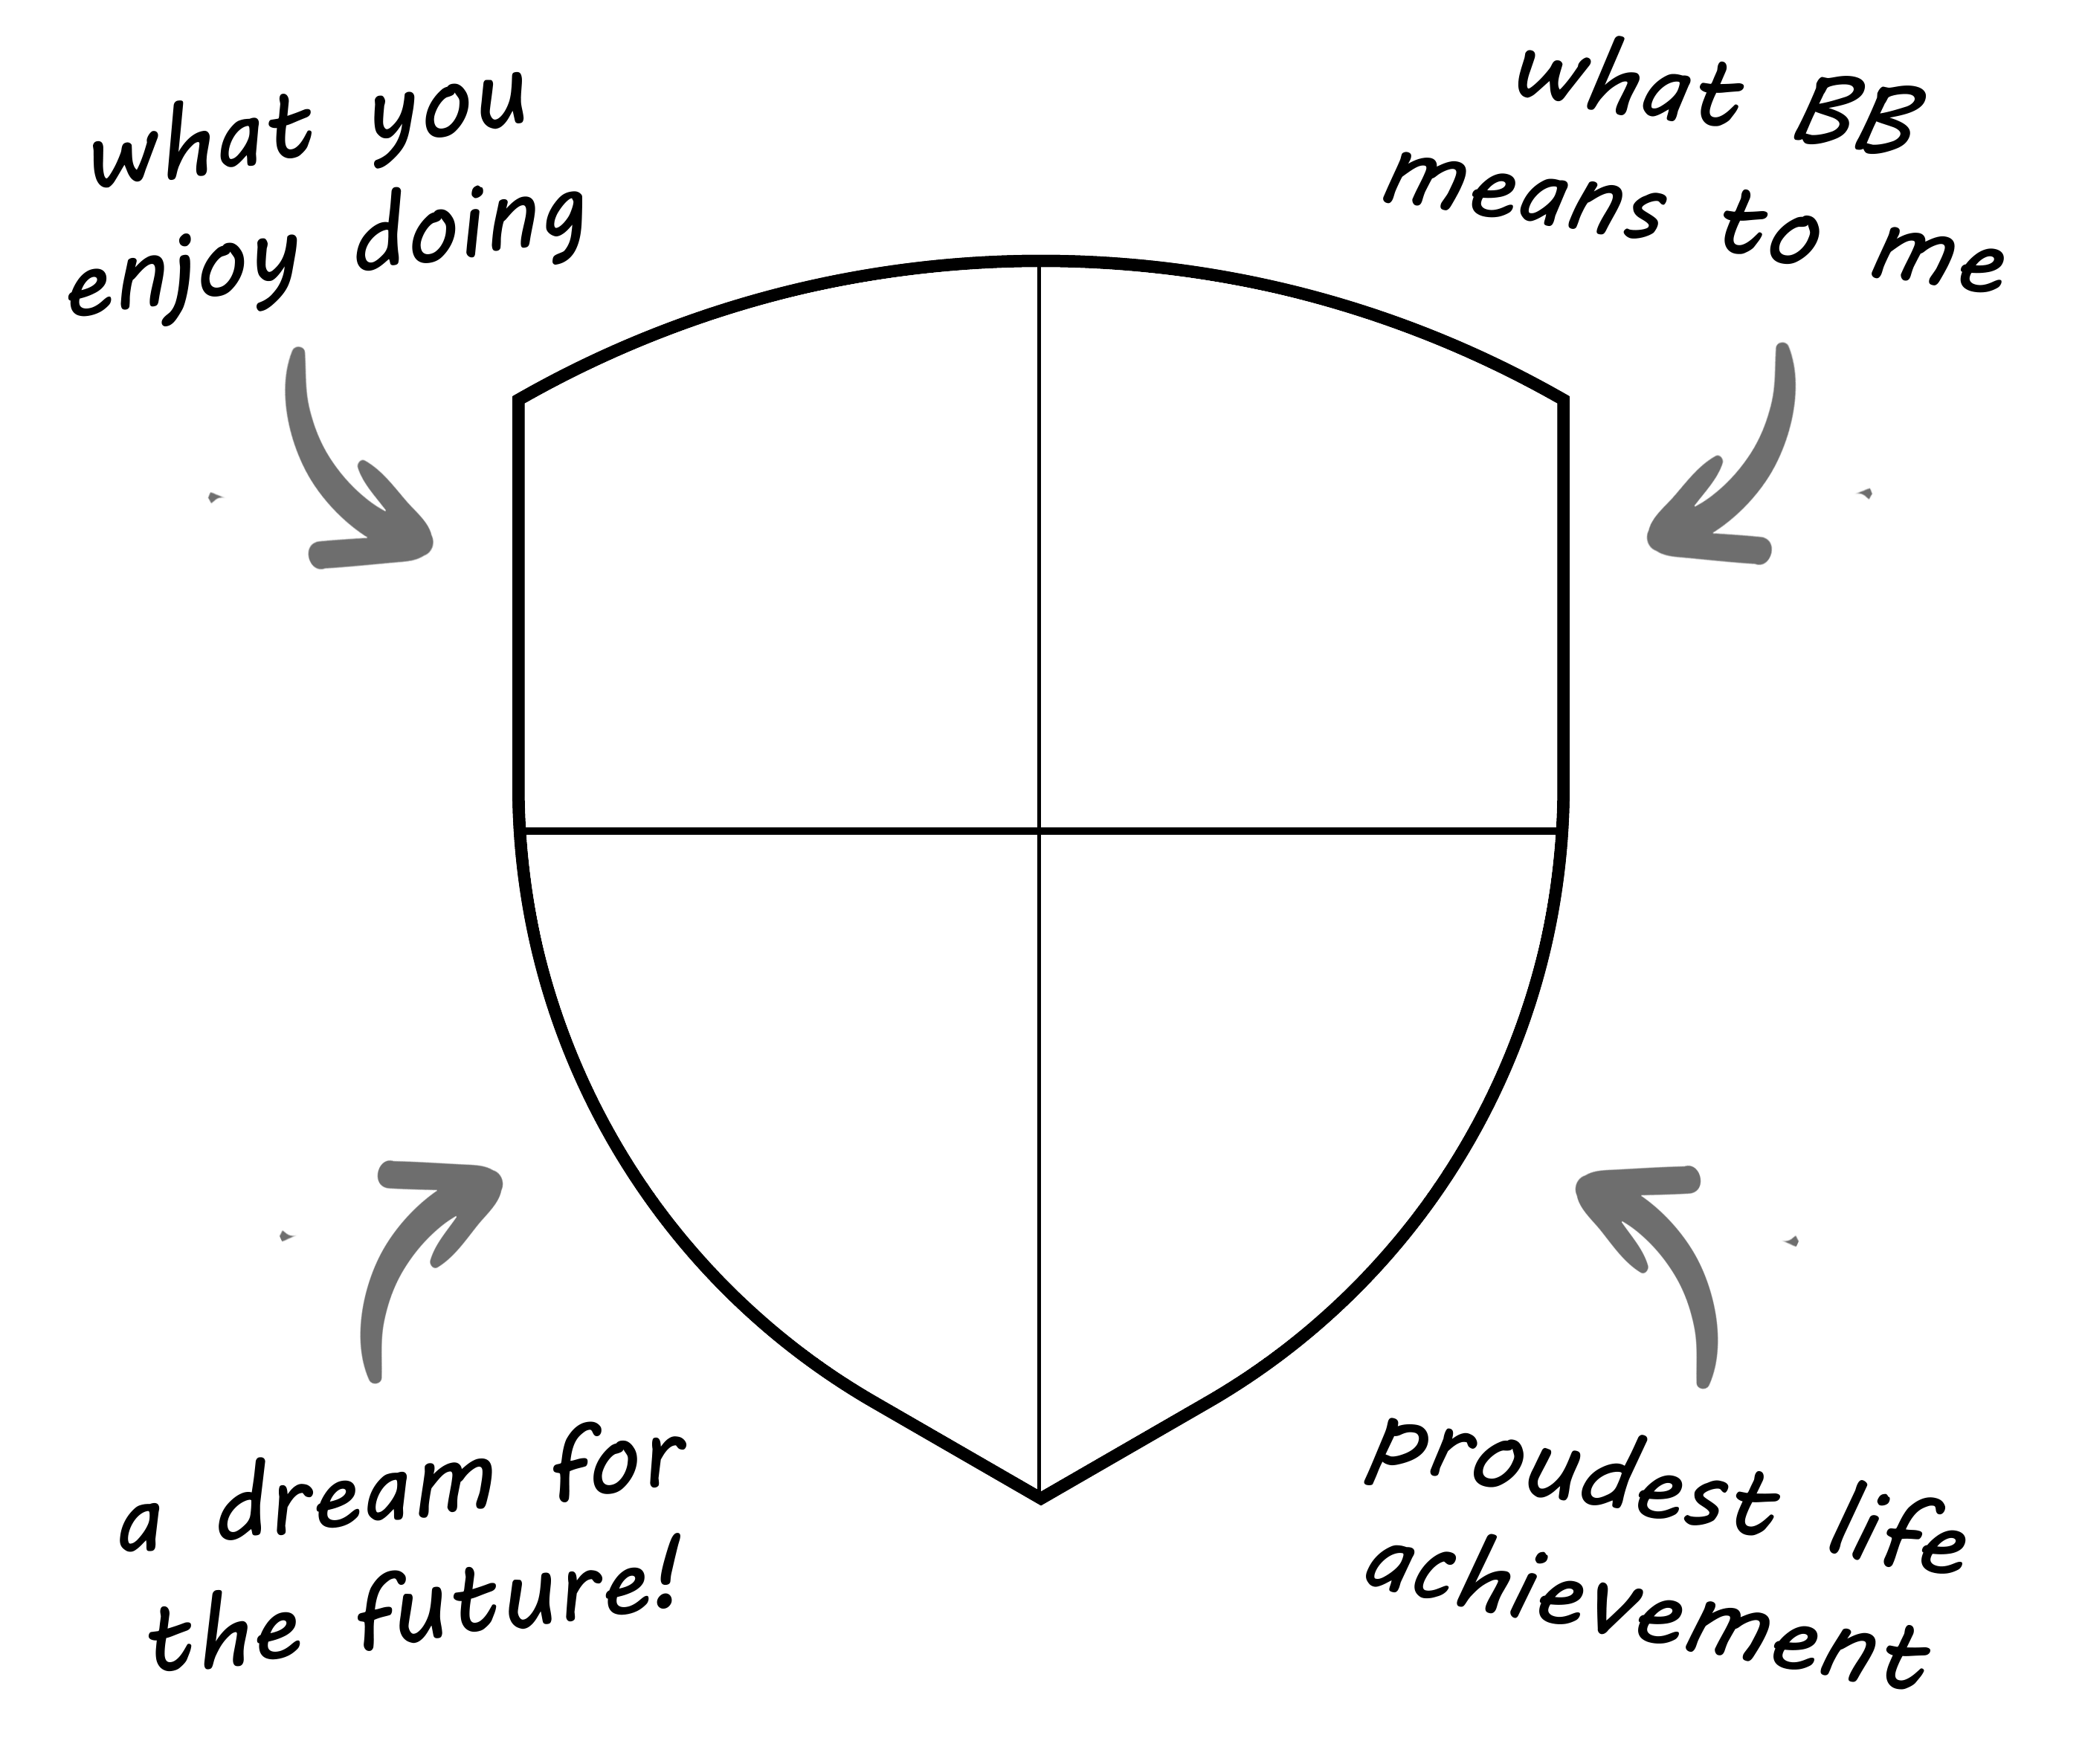
MY SHIELD ACTIVITY
An opportunity to get to know the group a little better.

Slide 6
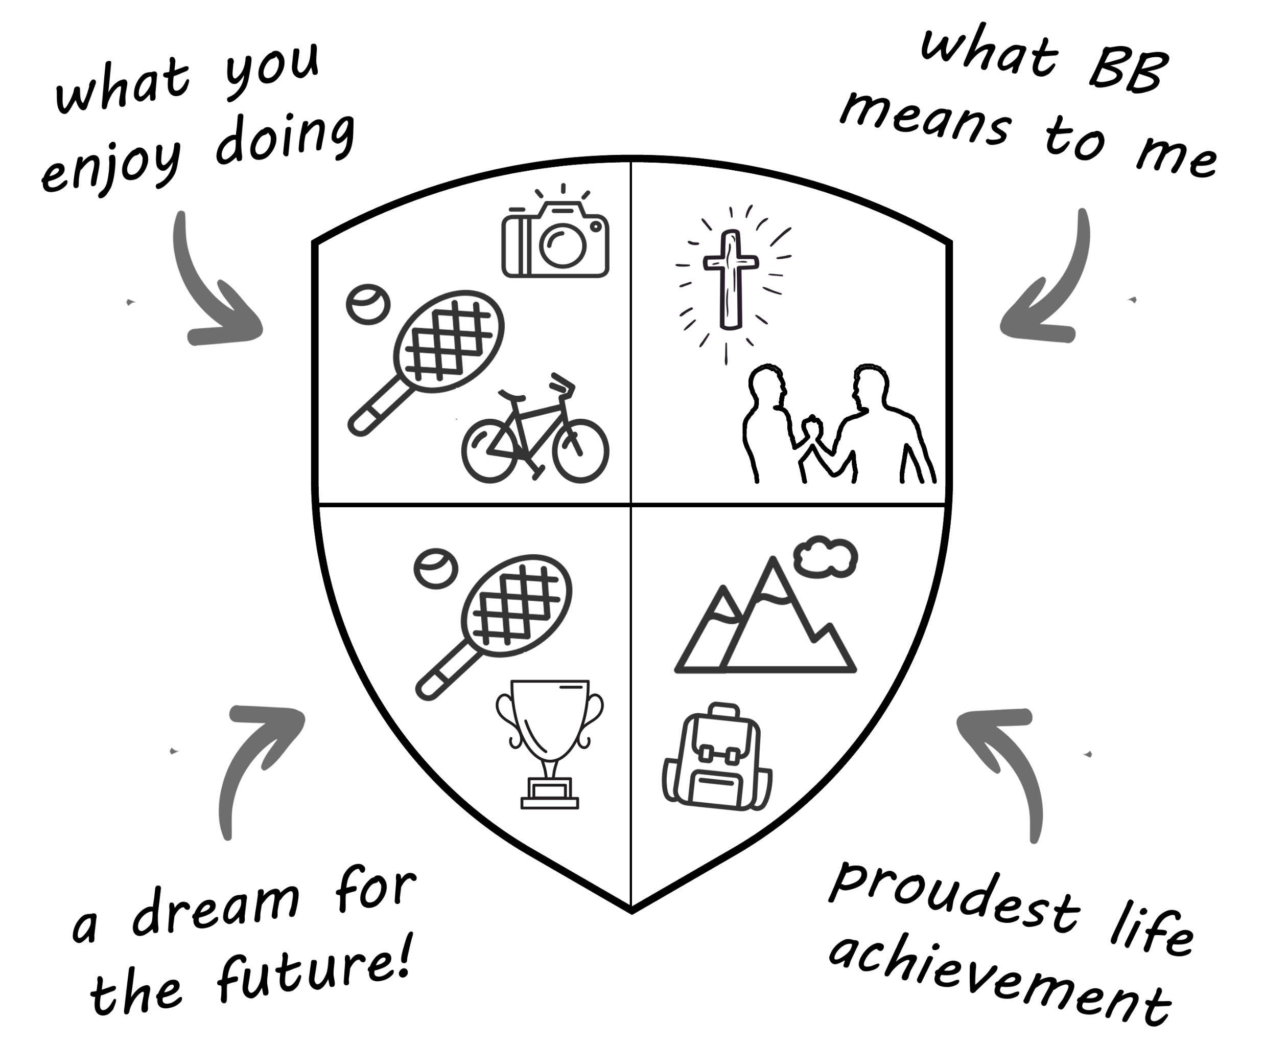

Slide 8
MY JOURNEY
An opportunity to reflect on your journey to this point and appreciate the hard work and progress that has been made. Looking at your BB, King’s Badge and faith journeys.

Slide 9
MY BB JOURNEY
When did you first join The Boys’ Brigade?
Why / how did you join?
What has been your highlight or proudest achievement of your time in the BB?
Which part of the BB have you enjoyed the least?
If you could go back to the day you joined BB and give your younger self one piece of advice about their BB journey to come, what would you say?

Slide 10
MY KING’S BADGE JOURNEY
What have you done for your King’s Badge? (volunteering, leadership, physical etc)
What has been the highlight of completing the King’s Badge?
Which area did you find the most challenging?
What can you take away from your King’s Badge experience that can be used in the future? (i.e a skill, increased confidence, knowing you can see things through etc).

Slide 11
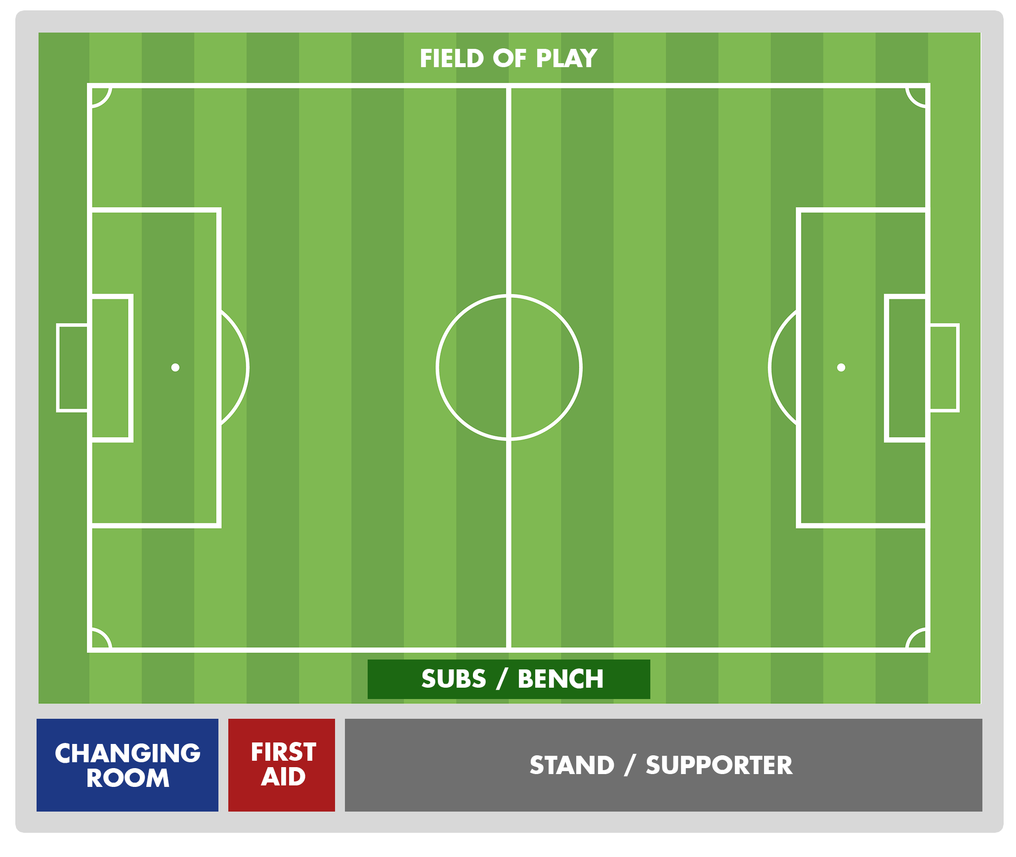
MY FAITH JOURNEY
Attack
Defence
Stand
Subs bench
Changing Room
First Aid
Outside

Slide 12
MY
FAITH
JOURNEY
Where are
you on the
field of play?
Attack
Defence
Stand
Subs bench
Changing Room
First Aid
Outside

Slide 13
MY FAITH JOURNEY
Where would you place yourself on the football pitch?
Have you always been in that position, or has it changed over time? If it has changed, what caused that change?
Is the current position the position you want to be in? Or would you like to move up or down the pitch? If so, where would you like to move to and what do you need to do in order to do so?

Slide 15
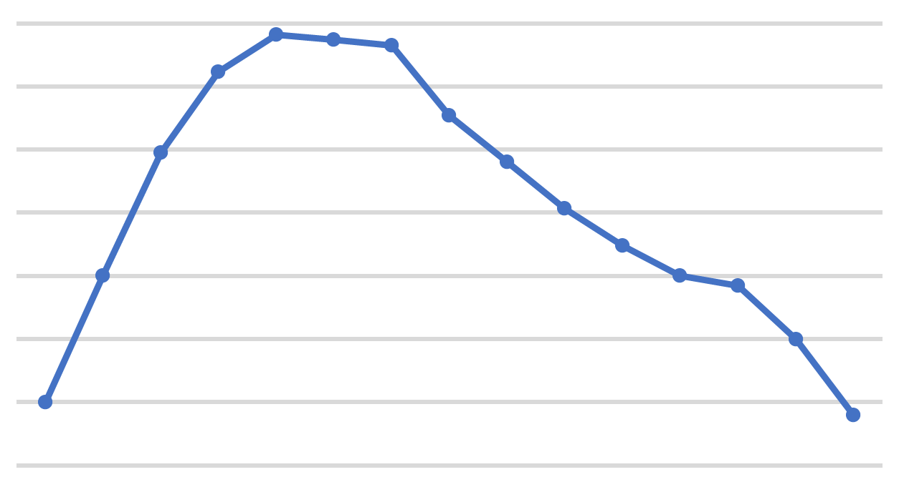
PROJECT: DRAGON’S DEN

Slide 16
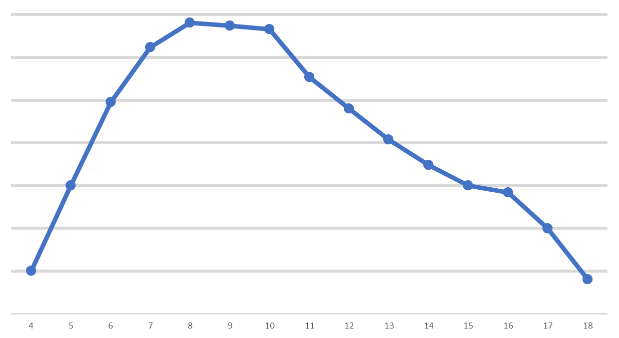
MEMBERSHIP OF THE BOYS’ BRIGADE BY AGE
NUMBER OF MEMBERS
AGE OF MEMBER

Slide 17
WHY ARE WE STILL HERE?
How many members were in your year group during Anchors/Juniors and how many are in your age group now?
Why do you think that change in numbers has happened?
What were the reasons for people leaving?
Why did you choose to stay?

Slide 19
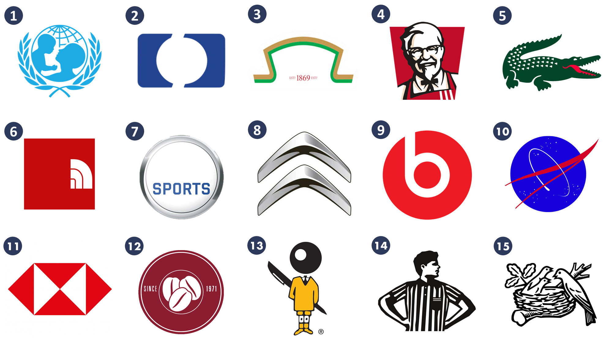
PROJECT: DRAGON’S DEN - BRAND
A look at different brands and the messages behind them. What is brand BB?

Slide 21
PROJECT: DRAGON’S DEN - BRAND
Answers:
UNICEF
HP
Heinz
KFC
Lacoste
North Face
EA Sports
8) Citroen
9) Beats
10) NASA
11) HSBC
12) Costa Coffee
13) Bic Pens
14) Footlocker
15) Nestle

Slide 22


WHAT ARE THE VALUES / MESSAGES / TARGET MARKETS?

Slide 23
WHAT IS BRAND BB?
What is The Boys’ Brigade’s brand? What key words would you put against the brand?
What are our key messages & values?
Who is our target market?

Slide 24
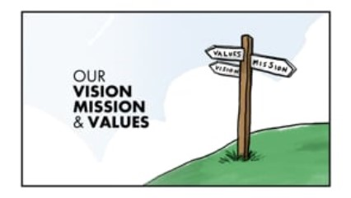

Slide 26
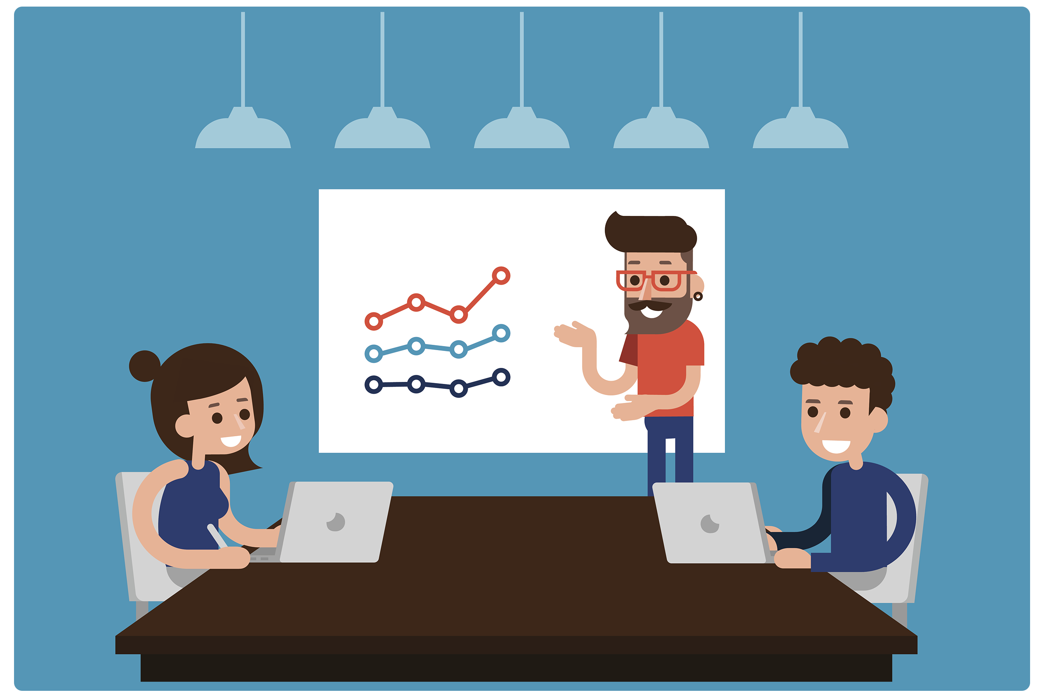
PROJECT: DRAGON’S DEN
Take the BB model and make any changes you wish, in order to present an improved / updated model you can pitch to the investors.

Slide 27
PROJECT: DRAGON’S DEN
Take the current BB model and make ANY changes you want to it, to create the best version of the BB that you can think of.
What activities / programme would you change / keep?
What values & aims of the organisation need to change?
What changes to our structure (i.e. age groups, genders, leadership etc) would you make?
What should a young person be entitled to when they finish their time with your version of the BB? (i.e. What will they have experienced / had the opportunity to do / skills gained etc?)

Slide 29
LETTERS – PARABLE OF THE TALENTS
What do you think the meaning of the parable is?
Why does the master give different amounts instead of the same amount to each person?
Does God give the same abilities and talents to us? Why not?
Using the parable as an example, what do you think God wants us to do with our talents that he has given us?

Slide 31
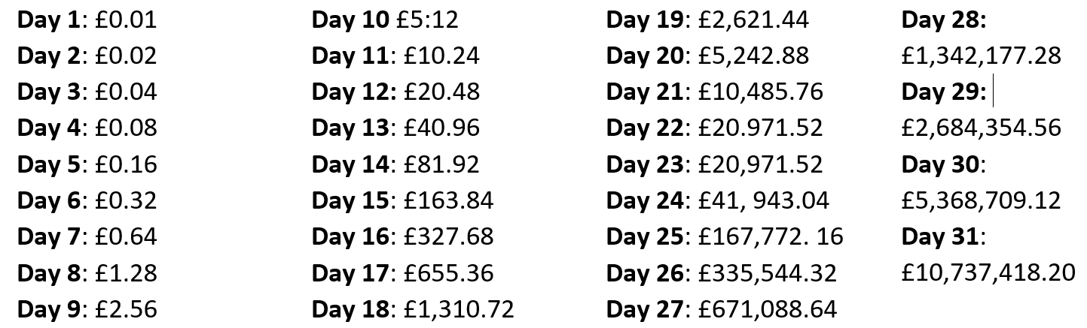
CHOICES - £1 MILLION OR 1P?

Slide 32
CHOICES - £1 MILLION OR 1P?
What decision have you made (or making) about university / work going forwards?
What thought have you given (if any) to your future in the BB as a leader?
Have you made your mind up about God yet?

Slide 34
RECAP ON OUR OBJECTIVES
Reflect on your life experiences up to this point.
Think about the journey working towards the King’s Badge has taken you on.
Start to explore what you want from the future
Tick off the final requirement for the King’s badge
Meet and hear from other young people in a similar position to you
Have fun!

