Slide 1
If you have not already downloaded and installed the Brigade fonts used in this presentation you can download our font pack at http://leaders.boys-brigade.org.uk/ourbrand.htm
Alternatively you may just need to check through the presentation to ensure the substitute font used is displaying correctly.

Slide 2


Slide 3

HOW WILL THE SESSION WORK?
Welcome (5 mins)
Ice Breakers (15 mins)
Opening Devotions - Biblical Leaders (10 mins)
Leadership Matters (15 mins) – Who’s Who
Leadership in BB (40 mins)
Break (5 mins)
Planning an Activity (25 mins)
Leading an Activity (30 mins)
Going Forwards & Goodbyes (5 mins)

Slide 4
TODAY’S OBJECTIVES
Consider the different qualities of leadership and what makes a good leader.
Understand the different knowledge, skills and attitudes that make up a leader.
Think about the different considerations a leader needs to think about when running activities.
To develop and share new activities and ideas for working with children
Tick off an important requirement for the King’s badge (preparing for your volunteering in the BB)
Meet and get to know other young people from different groups
Have fun!

Slide 6

LEADERSHIP MATTERS: WHO’S WHO
A look at well-known leaders and what makes them a ‘good’ or ‘bad’ leader.
SMALL GROUP ACTIVITY:
Who’s Who

Slide 7
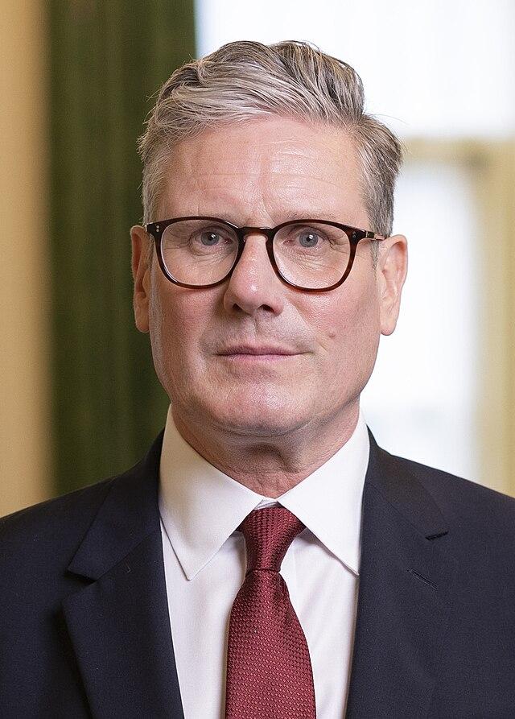
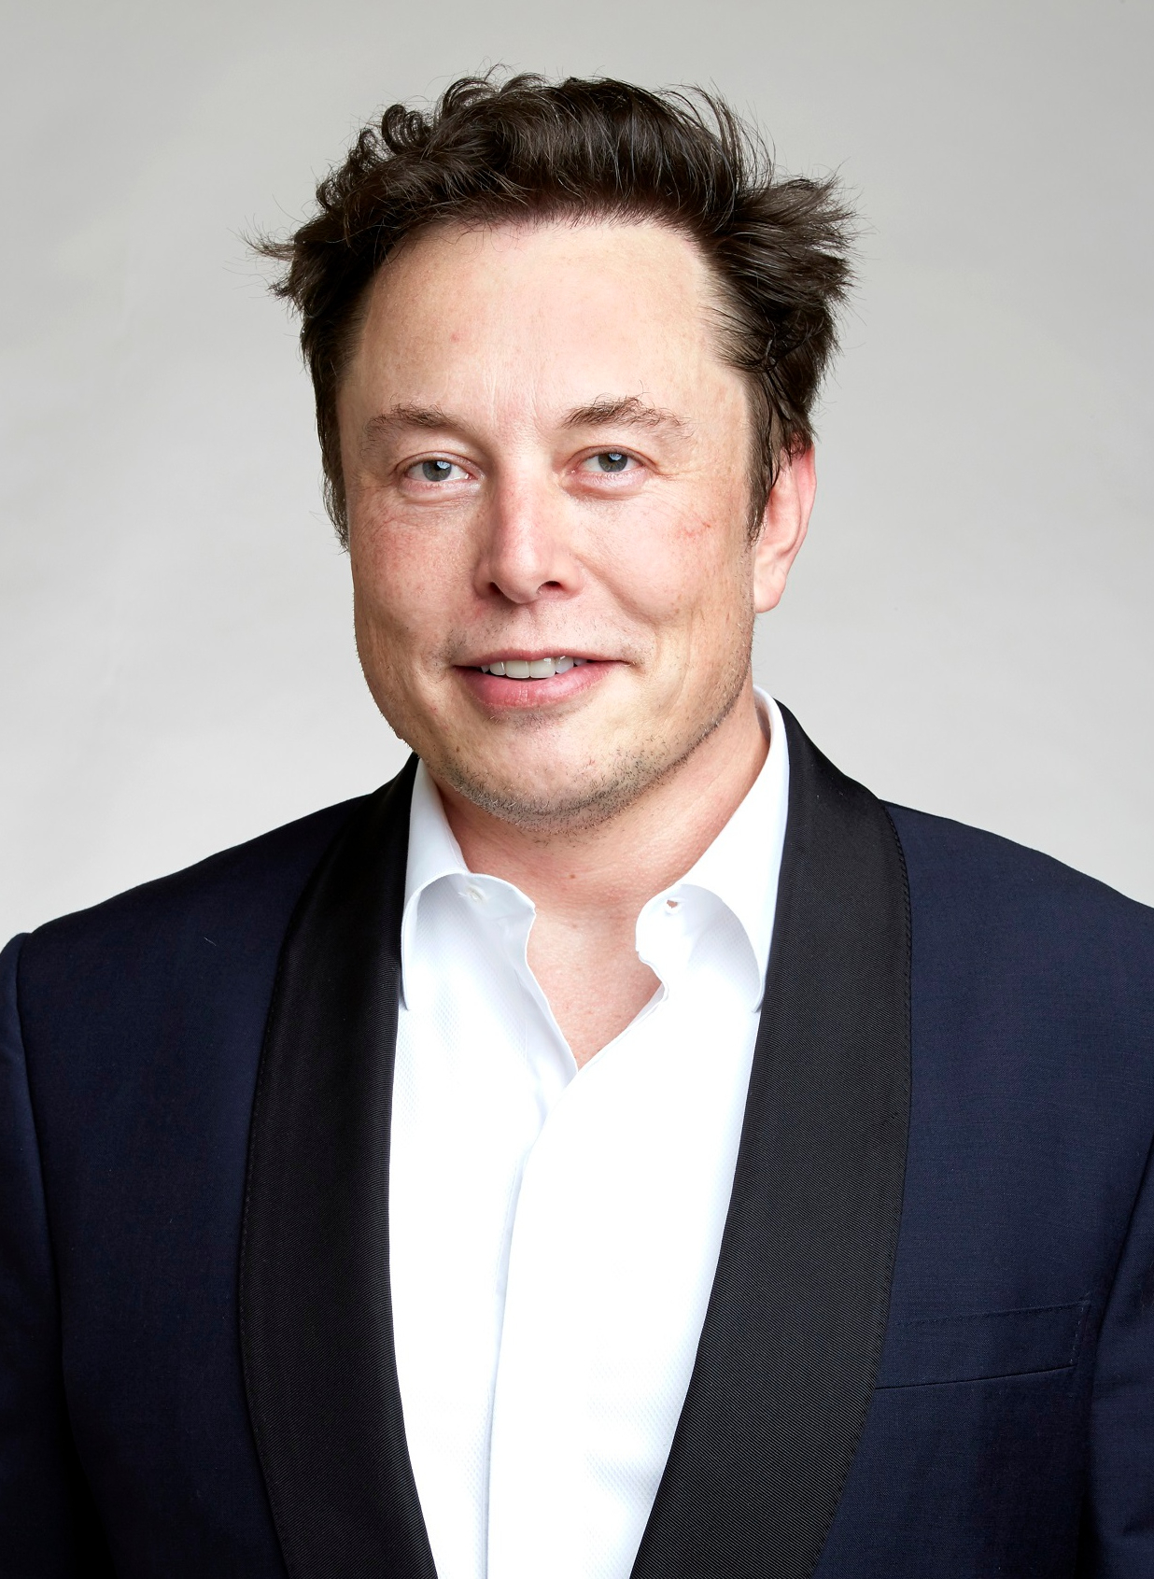
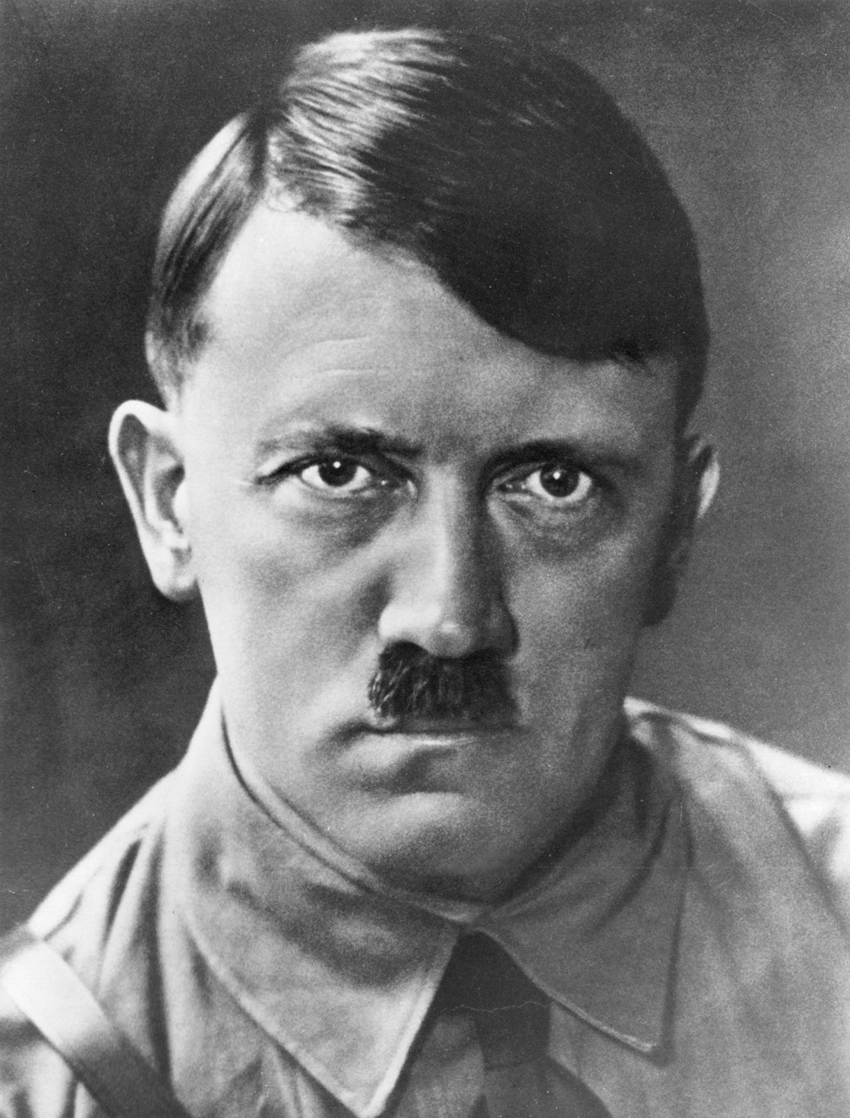
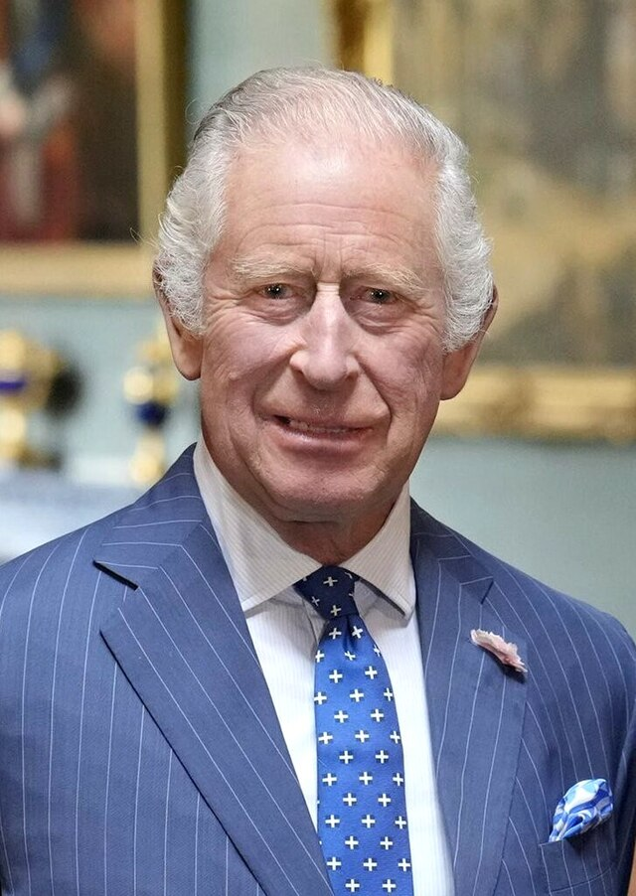

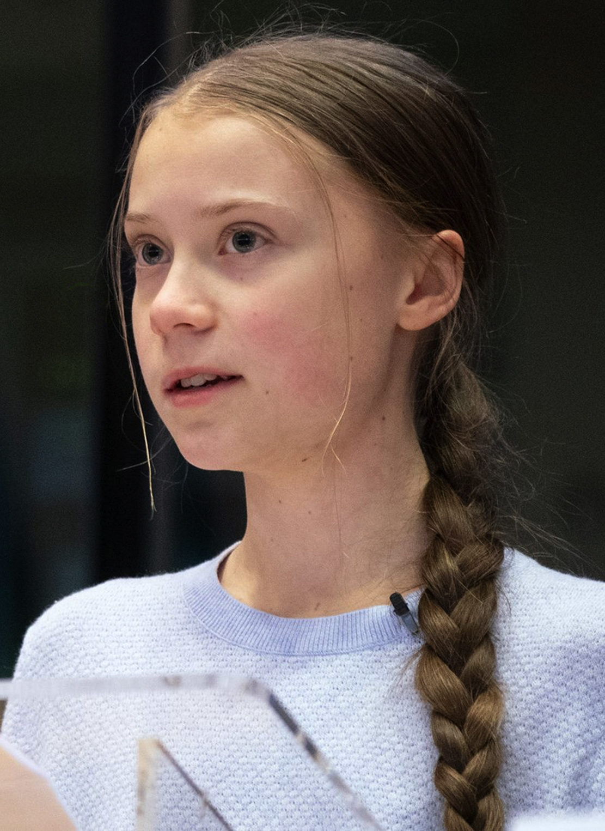
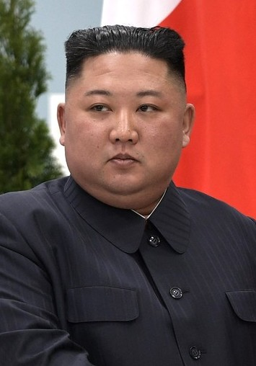
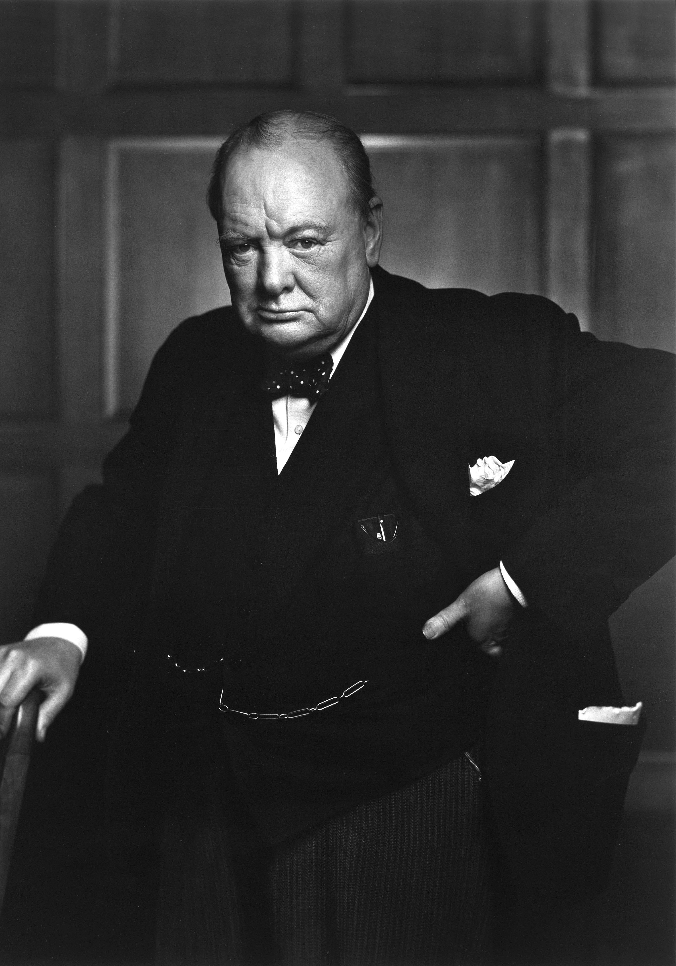

Slide 8

LEADERSHIP IN BB: AGREEMENT LINE
An activity that looks at different opinions of leadership in the BB and encourages debates between participants, exploring different viewpoints.
WHOLE GROUP ACTIVITY: Agreement Line

Slide 9
LEADERSHIP IN BB: ACTIVITIES & LEADERS
To take a look at two of the most important aspects of BB – activities and leaders. Participants will explore what makes for a good leader and a good activity and why both are important.
SMALL GROUP ACTIVITY:
Activities & Leaders
Knowledge, Skills & Attitudes

Slide 10
LEADERSHIP IN BB: ACTIVITIES & LEADERS
So, what’s more important . . .
Activities or Leaders?

Slide 11
LEADERSHIP IN BB: JOB ADVERT
To continue thinking about what makes a good BB leader by creating a job advert, designed to find the perfect leader. What should be included in the person specification?
SMALL GROUP ACTIVITY:
Job Advert

Slide 13
PRACTICALITIES OF LEADERSHIP:
PLANNING AN ACTIVITY
To think about the practicalities of leadership and running BB activities.
SMALL GROUP ACTIVITY:
Planning an Activity

Slide 14
PRACTICALITIES OF LEADERSHIP:
LEADING AN ACTIVITY
To think about the practicalities of leadership and running BB activities.
SMALL GROUP ACTIVITY:
Leading an Activity

Slide 16
RECAP ON TODAY’S OBJECTIVES
Consider the different qualities of leadership and what makes a good leader.
Understand the different knowledge, skills and attitudes that make up a leader.
Think about the different considerations a leader needs to think about when running activities.
To develop and share new activities and ideas for working with children
Tick off an important requirement for the King’s badge (preparing for your volunteering in the BB)
Meet and get to know other young people from different groups
Have fun!

