Slide 2
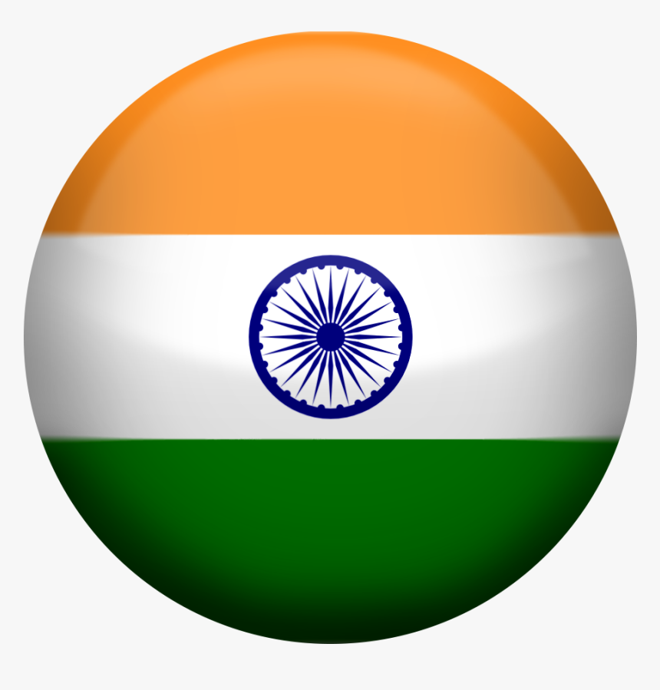
LARGEST POPULATION

Slide 3
LARGEST POPULATION
67 MILLION

Slide 4
LARGEST POPULATION
67 MILLION
1.4 BILLION

Slide 5
CARS PER 1000 PEOPLE

Slide 6
CARS PER 1000 PEOPLE
575

Slide 7
CARS PER 1000 PEOPLE
575
45

Slide 8
CRICKET WORLD CUP WINS (MENS)

Slide 9
CRICKET WORLD CUP WINS (MENS)
1

Slide 10
CRICKET WORLD CUP WINS (MENS)
1
2

Slide 11
McDONALD’S RESTURANTS

Slide 12
McDONALD’S RESTURANTS
1,300

Slide 13
McDONALD’S RESTURANTS
1,300
300

Slide 14
LIFE EXPECTANCY

Slide 15
LIFE EXPECTANCY
81

Slide 16
LIFE EXPECTANCY
81
70

Slide 17
TOTAL OLYMPIC MEDALS

Slide 18
TOTAL OLYMPIC MEDALS
948

Slide 19
TOTAL OLYMPIC MEDALS
948
35

Slide 20
AVERAGE ANNUAL RAINFALL

Slide 21
AVERAGE ANNUAL RAINFALL
1077mm

Slide 22
AVERAGE ANNUAL RAINFALL
1077mm
1160mm

Slide 23
NUMBER OF COWS

Slide 24
NUMBER OF COWS
9.4 MILLION

Slide 25
NUMBER OF COWS
9.4 MILLION
305 MILLION

