Slide 1
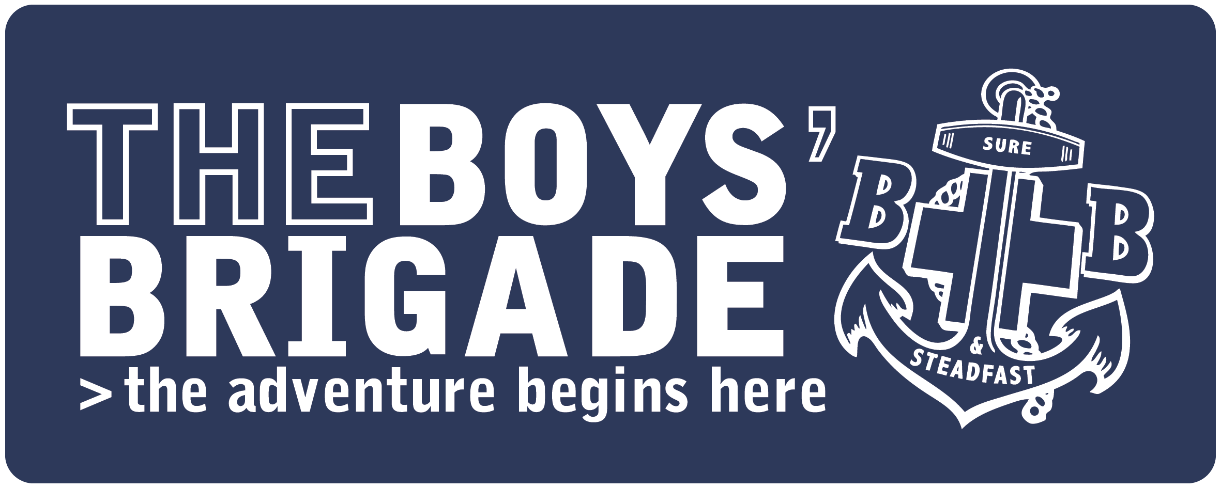
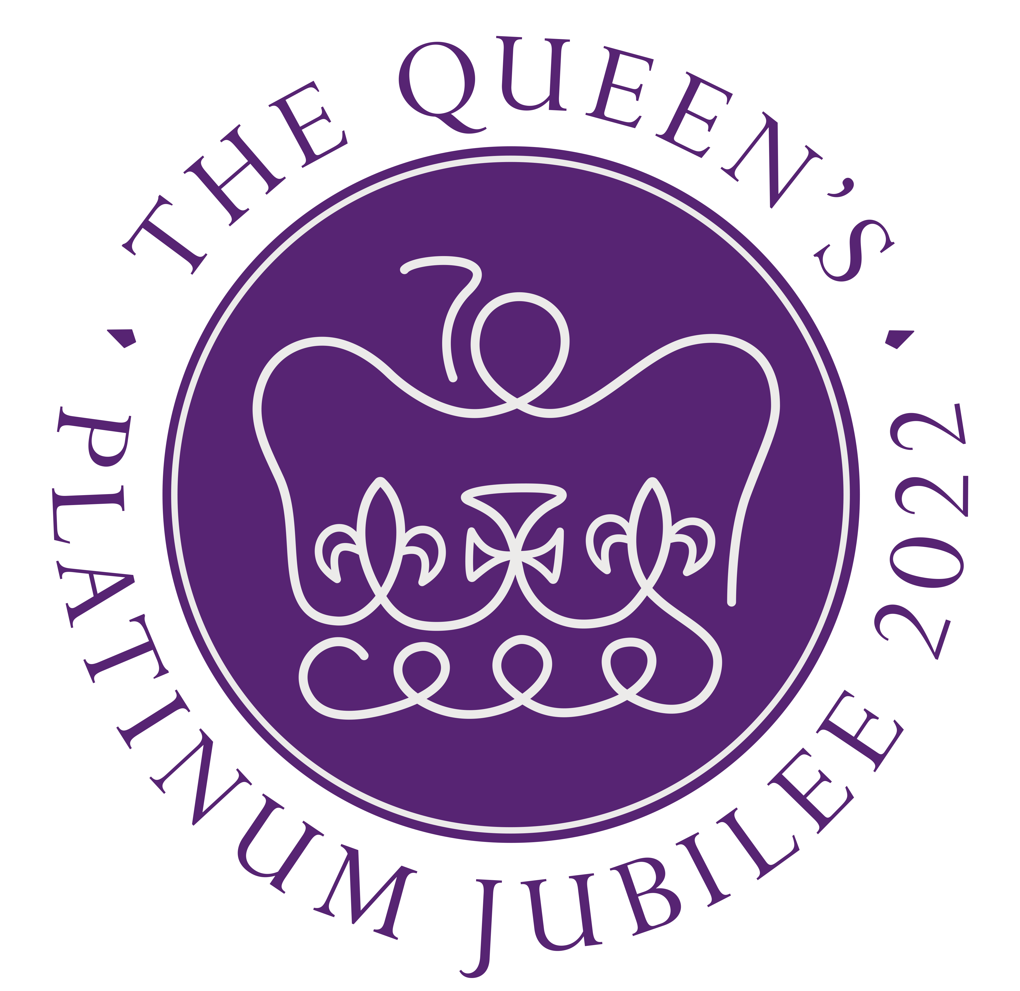
THE QUEEN & THE CROWN

Slide 2


HOW MANY CROWNS DID THE QUEEN WEAR AT HER CORONATION?
1
2
3

Slide 3

HOW MANY CROWNS DID THE QUEEN WEAR AT HER CORONATION?
Fun Fact!
The Queen wore one crown to arrive in, one crown when she was ‘crowned’ Queen and then a third crown to leave in.
3

Slide 4
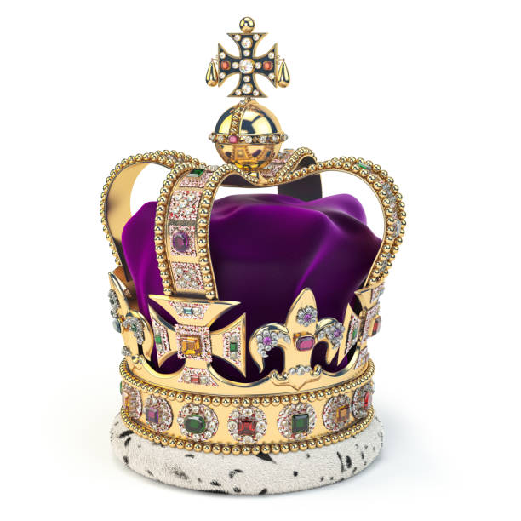
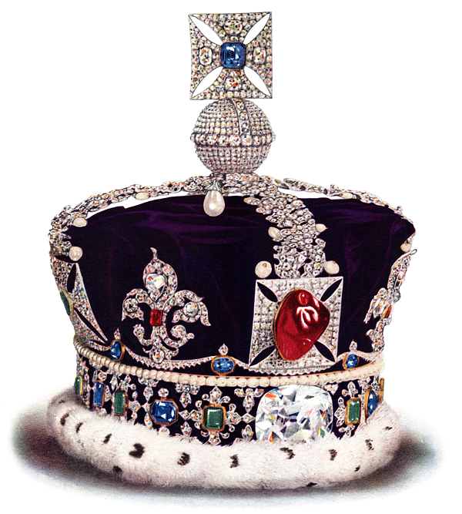
MEET
THE
CROWNS
ST EDWARD’S CROWN (CORONATION CROWN)
IMPERIAL STATE
CROWN

Slide 5
HOW MANY TIMES HAS THE QUEEN WORN ST EDWARD’S CROWN?
ONCE A YEAR ON HER CORONATION DATE
ONLY EVER ONCE
EVERY NIGHT TO BED

Slide 6
HOW MANY TIMES HAS THE QUEEN WORN ST EDWARD’S CROWN?
Fun Fact!
The only time St Edward’s Crown is used, is to crown the King or Queen. The Queen therefore hasn’t worn it since!
ONLY EVER ONCE

Slide 7
WHAT MATERIAL IS ST EDWARD’S CROWN MADE FROM?
RECYCLED PLASTIC
SILVER
GOLD

Slide 8
WHAT MATERIAL IS ST EDWARD’S CROWN MADE FROM?
Fun Fact!
St Edward’s crown is made from solid gold, it’s 30cm tall and it’s decorated with 444 precious stones. It’s priceless!
GOLD

Slide 9
HOW HEAVY IS ST EDWARD’S CROWN?
1.23KG (1 BAG OF SUGAR)
2.23KG (2 BAGS OF SUGAR)
3.23KG (3 BAGS OF SUGAR)

Slide 10
HOW HEAVY IS ST EDWARD’S CROWN?
Fun Fact!
2 bags of sugar might not sound like a lot, but imagine balancing that on your head whilst millions of people around the world watched you.
2.23KG (2 BAGS OF SUGAR)

Slide 11
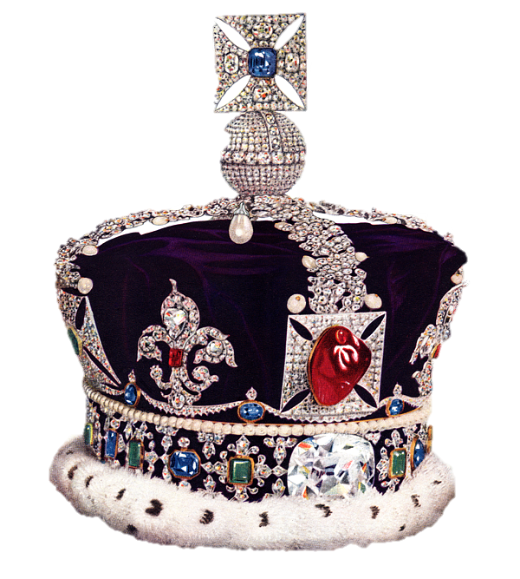
THE QUEEN’S OTHER CROWN, THE IMPERIAL STATE CROWN, IS A BIT SMALLER AND HALF THE WEIGHT. IT IS HOWEVER NO LESS FANCY.
HOW MANY DIAMONDS ARE IN THE IMPERIAL STATE CROWN?
868
1,868
2,868

Slide 12
HOW MANY DIAMONDS ARE IN THE IMPERIAL STATE CROWN?
Fun Fact!
As well as 2868 diamonds, the crown also has 273 pearls, 17 sapphires, 11 emeralds and 5 rubies. That’s a lot of bling!
2,868

Slide 13
WHO IS ALLOWED TO TOUCH THE CROWN?
JUST THE QUEEN AND HER FAMILY
JUST THE QUEEN, THE ARCHBISHOP OF CANTERBURY AND THE QUEEN’S JEWELLER
JUST PEOPLE WHO ARE CALLED ELIZABETH

Slide 14
WHO IS ALLOWED TO TOUCH THE CROWN?
Fun Fact!
The Queen can wear it, the archbishop can touch it to place it on the Queen’s head and the jeweller can touch it to fix and clean it. But that’s it. No-one else can touch the crown!
JUST THE QUEEN, THE ARCHBISHOP OF CANTERBURY AND THE QUEEN’S JEWELLER

Slide 15
WHERE ARE THE QUEEN’S CROWNS KEPT WHEN SHE ISN’T USING THEM?
THE TOWER OF LONDON
BUCKINGHAM PALACE
UNDER THE QUEEN’S BED

Slide 16
WHERE ARE THE QUEEN’S CROWNS KEPT WHEN SHE ISN’T USING THEM?
Fun Fact!
All of the Crown Jewels are kept very securely at the Tower of London. This has been the case for over 600 years!
THE TOWER OF LONDON

Slide 17
WHEN THE QUEEN OPENS PARLIAMENT EACH YEAR, THE CROWN GETS SOME SPECIAL TREATMENT. WHAT IS IT?
IT TRAVELS IN ITS OWN HORSE DRAWN CARRIAGE
IT GETS AN ARMED GUARD TO PROTECT IT
BEFORE THE QUEEN WEARS IT, IT ARRIVES ON A RED CUSHION

Slide 18
WHEN THE QUEEN OPENS PARLIAMENT EACH YEAR, THE CROWN GETS SOME SPECIAL TREATMENT. WHAT IS IT?
Fun Fact!
Sorry, that was a trick question! All three answers are correct. The crown is treated like a VIP as it represents the Queen’s authority and importance.
A, B & C!

Slide 19
DURING WORLD WAR 2, THE REALLY VALUABLE STONES WERE REMOVED FROM THE CROWN AND SECRETLY STORED WHERE?
A VERY STRONG SAFE IN BUCKINGHAM PALACE
TAKEN TO AUSTRALIA TO BE OUT OF HARM’S WAY
BURIED IN A BISCUIT TIN UNDERNEATH WINDSOR CASTLE

Slide 20
DURING WORLD WAR 2, THE REALLY VALUABLE STONES WERE REMOVED FROM THE CROWN AND SECRETLY STORED WHERE?
Fun Fact!
A biscuit tin would have been the last place the enemy would have looked, which is what made it the perfect hiding place!
BURIED IN A BISCUIT TIN UNDERNEATH WINDSOR CASTLE

