Slide 1
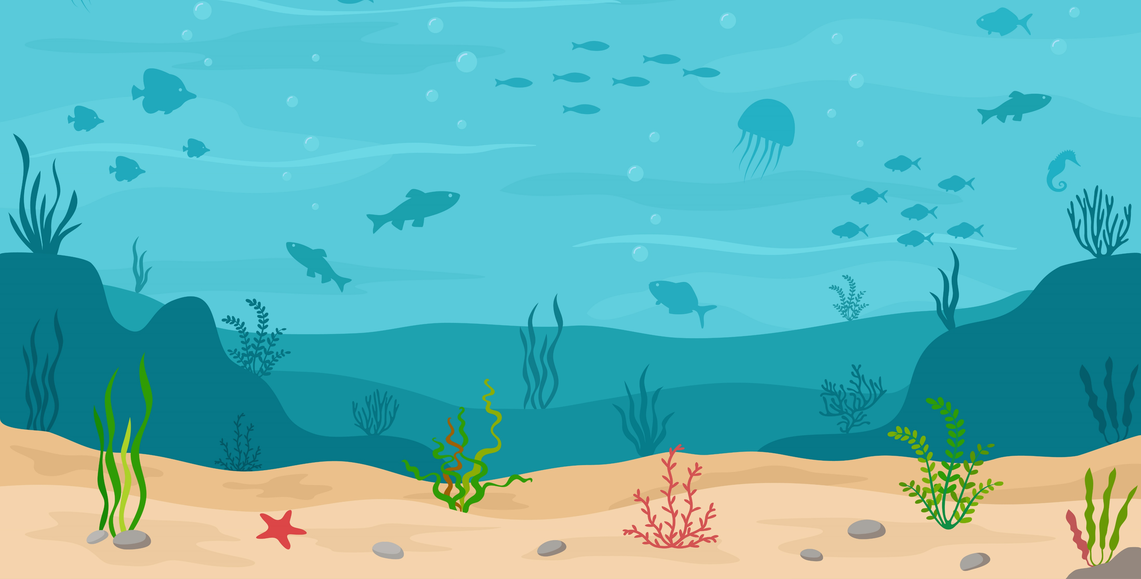
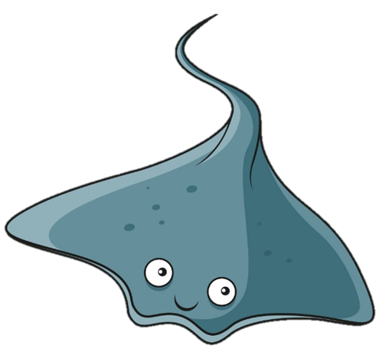
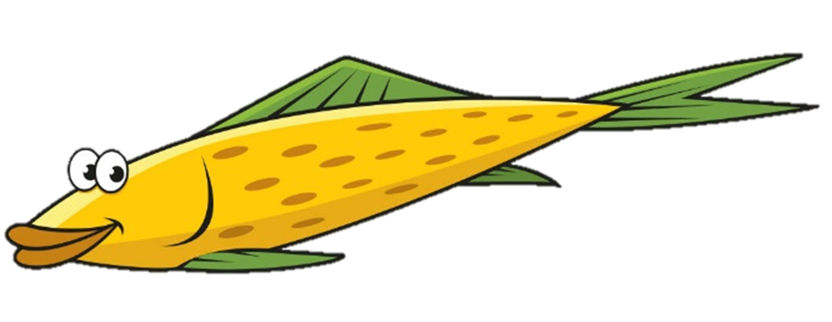
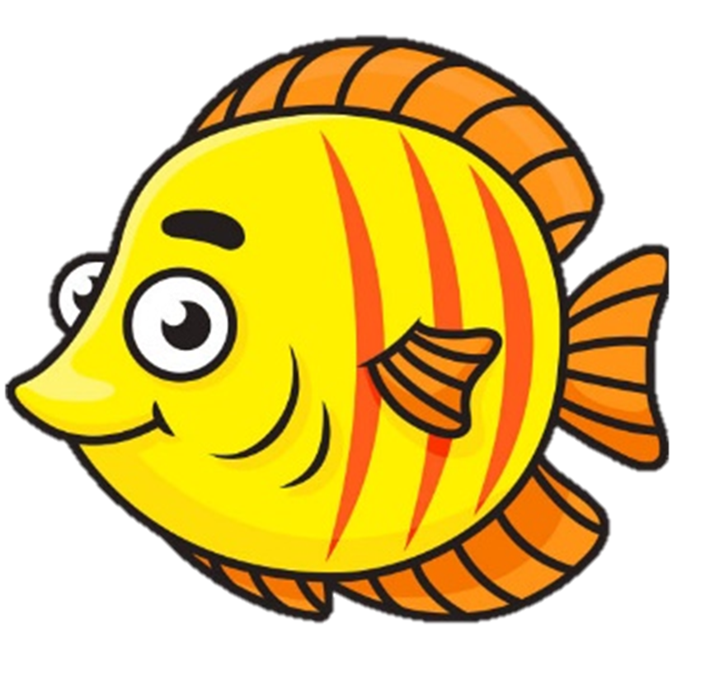
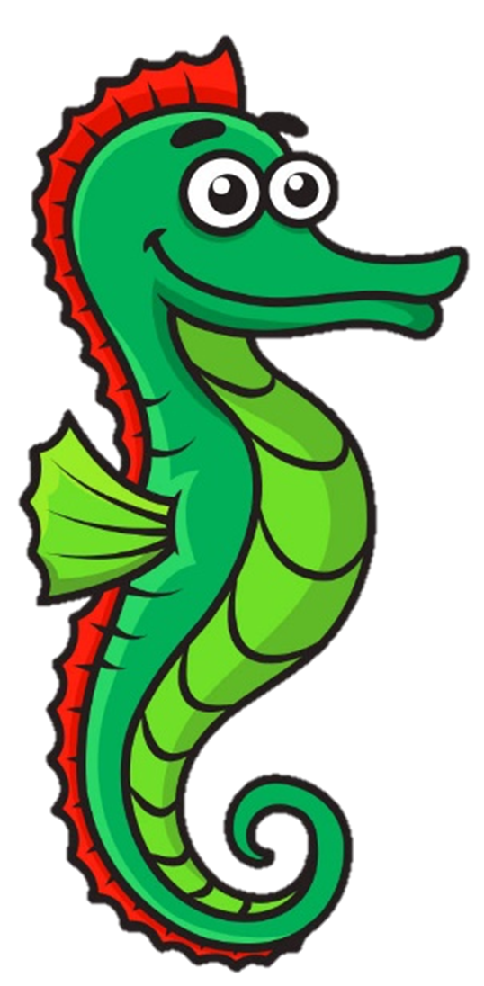
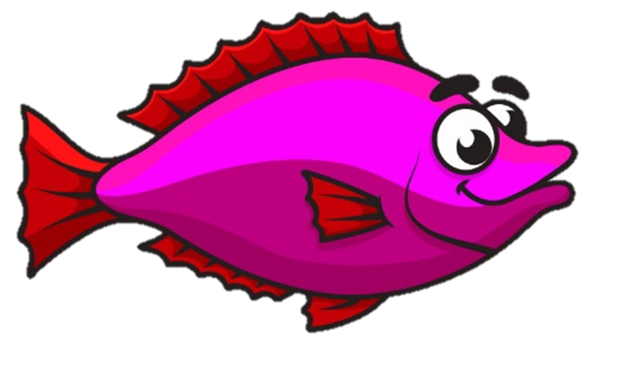
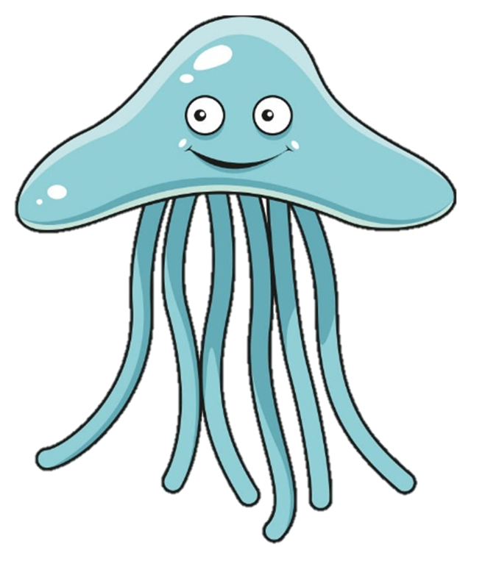
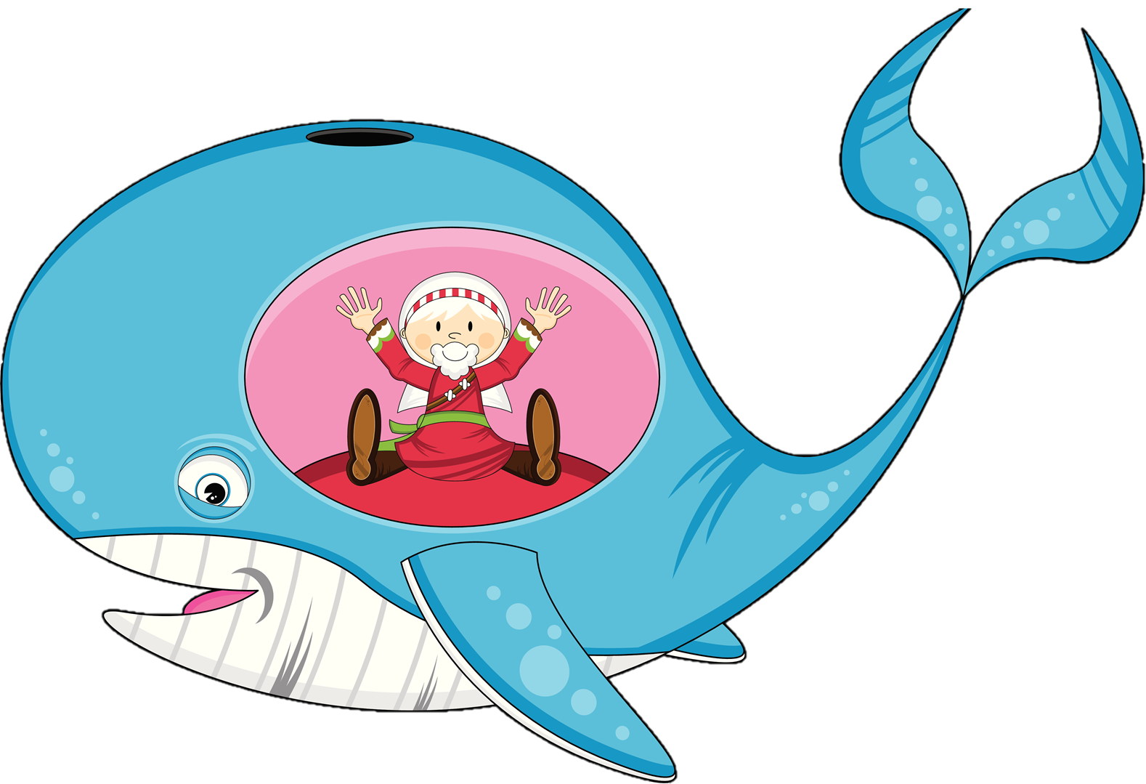
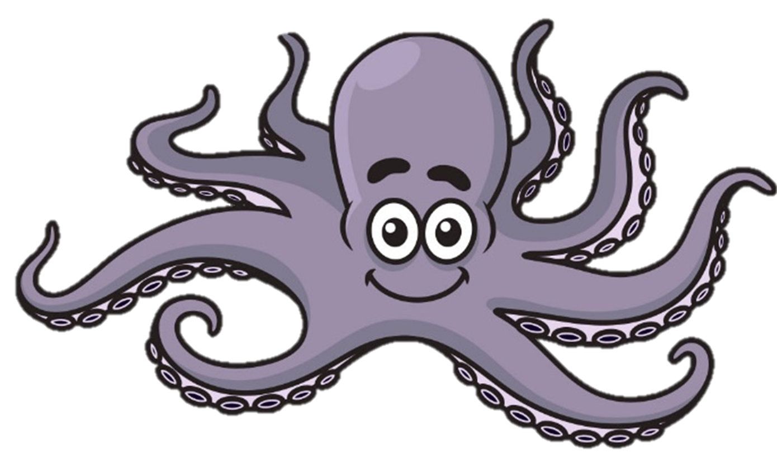
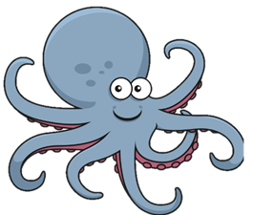
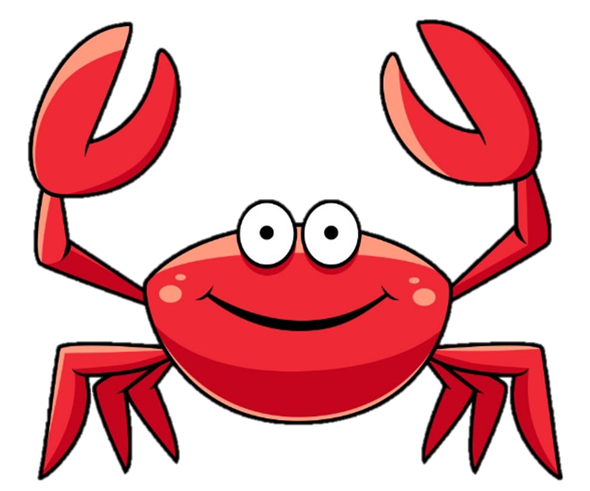
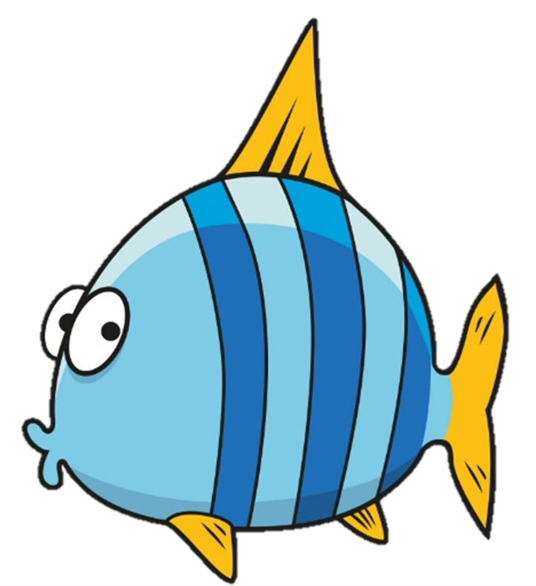
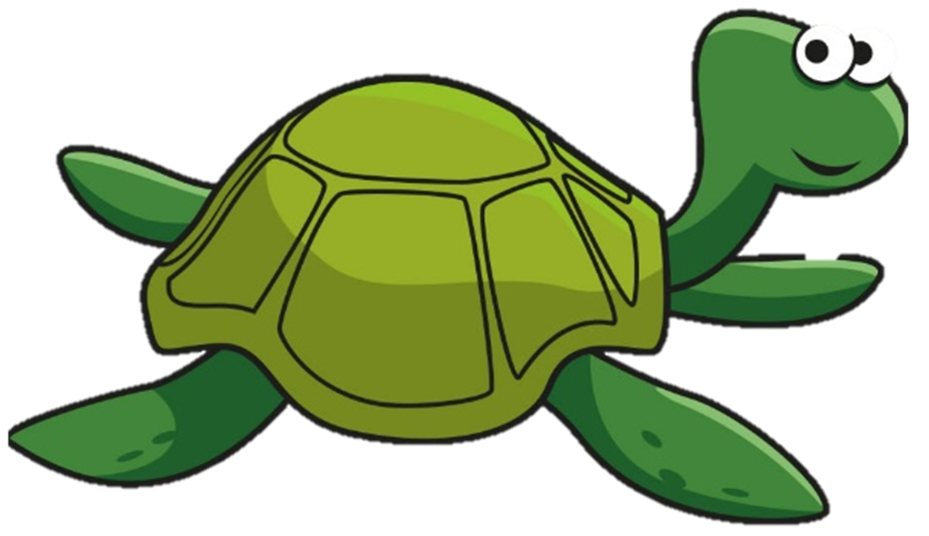
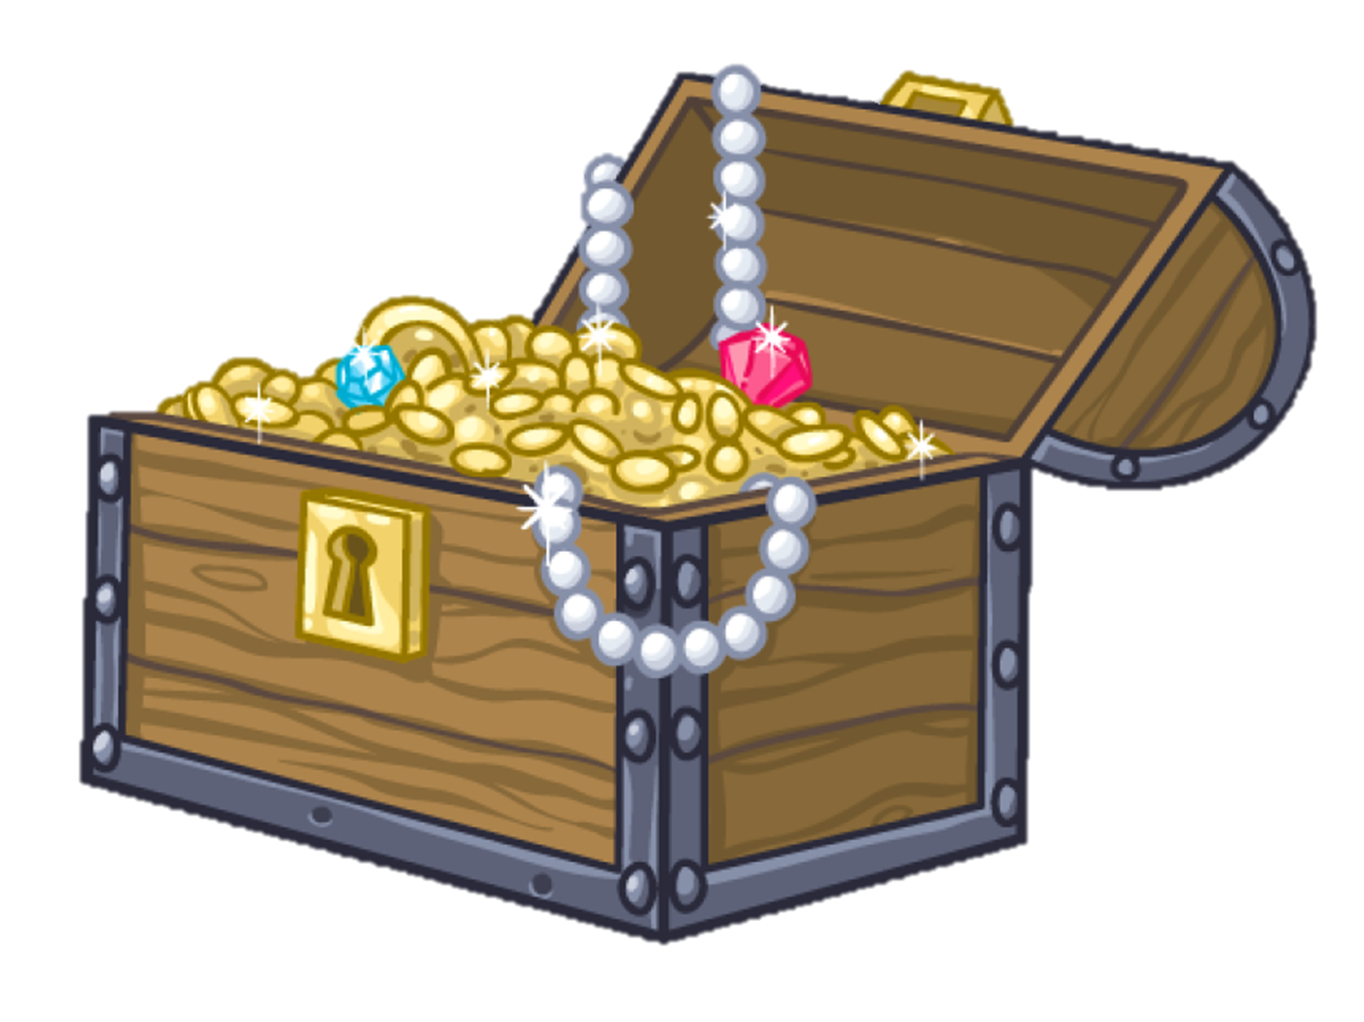
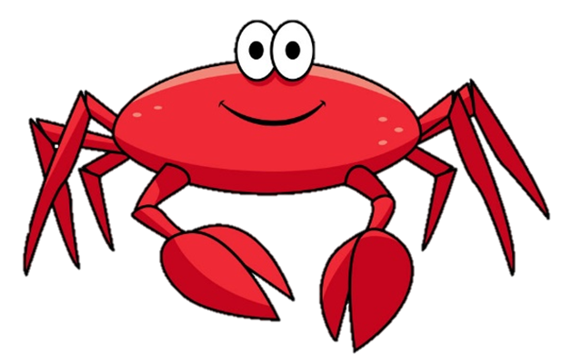
WHERE’S JONAH & FRIENDS?

Slide 2
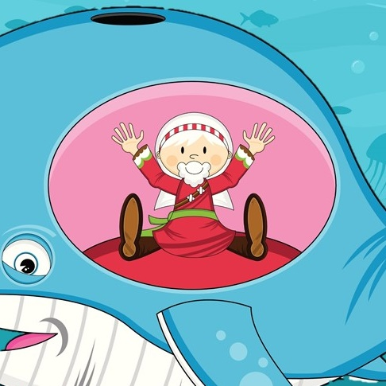
1. Trapped Jonah

Slide 3
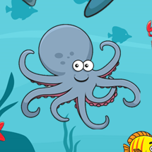
2. 8 Legged Octopus
1. Trapped Jonah

Slide 4
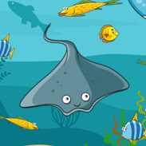
2. 8 Legged Octopus
1. Trapped Jonah
3. Smiling Stingrays

Slide 5
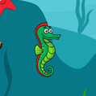
2. 8 Legged Octopus
4. Green Seahorses
1. Trapped Jonah
3. Smiling Stingrays

Slide 6
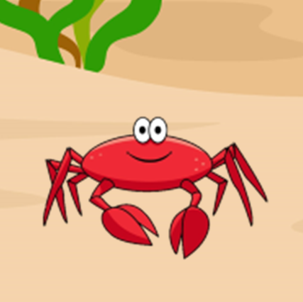
2. 8 Legged Octopus
4. Green Seahorses
1. Trapped Jonah
3. Smiling Stingrays
5. Red Snappy Crabs

Slide 7
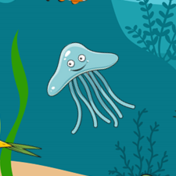
2. 8 Legged Octopus
4. Green Seahorses
6. Floating Jellyfish
1. Trapped Jonah
3. Smiling Stingrays
5. Red Snappy Crabs

Slide 8
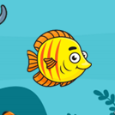
2. 8 Legged Octopus
4. Green Seahorses
6. Floating Jellyfish
1. Trapped Jonah
3. Smiling Stingrays
5. Red Snappy Crabs
7. Yellow & Orange Fish

Slide 9
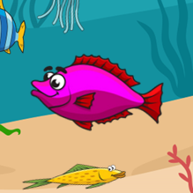
2. 8 Legged Octopus
4. Green Seahorses
6. Floating Jellyfish
8. Purple & Red Fish
1. Trapped Jonah
3. Smiling Stingrays
5. Red Snappy Crabs
7. Yellow & Orange Fish

Slide 10
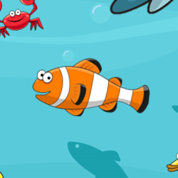
2. 8 Legged Octopus
4. Green Seahorses
6. Floating Jellyfish
8. Purple & Red Fish
1. Trapped Jonah
3. Smiling Stingrays
5. Red Snappy Crabs
7. Yellow & Orange Fish
9. Orange & White Fish

Slide 11
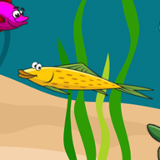
2. 8 Legged Octopus
4. Green Seahorses
6. Floating Jellyfish
8. Purple & Red Fish
10. Yellow & Green Fish
1. Trapped Jonah
3. Smiling Stingrays
5. Red Snappy Crabs
7. Yellow & Orange Fish
9. Orange & White Fish

