Slide 1
NOTES TO TRAINER
If you have not already downloaded and installed the Brigade fonts used in this presentation you can download our font pack at http://leaders.boys-brigade.org.uk/ourbrand.htm
Alternatively you may just need to check through the presentation to ensure the substitute font used is displaying correctly.
_________________________________________________________
This PowerPoint presentation may have videos embedded into it (these require a internet connection as are streamed from Vimeo), when you come to these click the play button to start the video. Ensure when sharing your screen through Zoom you tick the ‘Share Computer Sound’ box.

Slide 3
LEARNING OUTCOMES
By the end of this module participants will be able to:
Know the Vision, Mission and Values of The Boys’ Brigade
Identify what a BB leader needs in terms of knowledge, skills and attitudes in order to work effectively with children and young people
Name the four core values of youth work and understand how these form the framework for the content of Youth Leader Training

Slide 4
INTRODUCING THE BOYS’ BRIGADE
Whether you have grown up in the organisation or it’s all new to you, let’s start off by finding out more about the organisation we are a part of . . .
WATCH: Introduction to The Boys’ Brigade

Slide 6
VISION, MISSION & VALUES
We believe it is important that everyone in The Boys’ Brigade is aware of who we are, what we do and why we do it – this is set out in our Vision, Mission and Values.
WATCH: Introducing our Vision, Mission & Values

Slide 8
VISION & MISSION
In terms of Vision, Mission and Values, it is useful to remember these as . . .
WHO we are … the Values
WHAT we do … the Mission
WHY we do it … the Vision

Slide 9
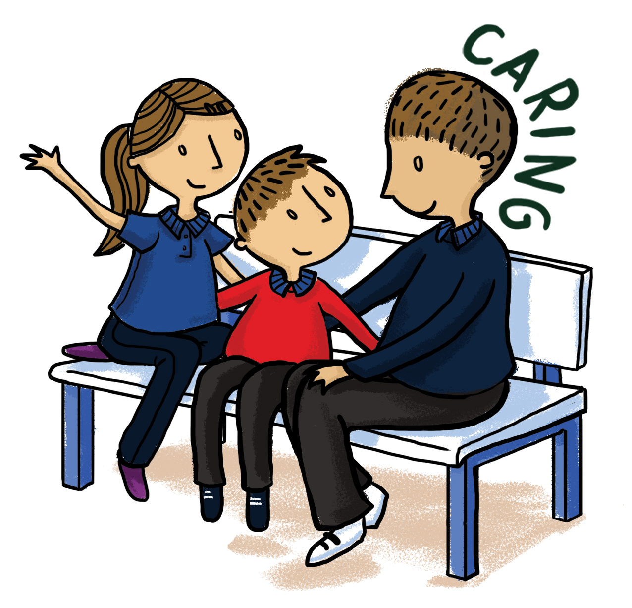
OUR VALUES
Faith - We are a Christian youth organisation, and our work is rooted in the Christian Faith. We have this hope, a sure and steadfast anchor of the soul (Hebrews 6:19)
Caring - The Boys’ Brigade is a family. We believe in building loving, caring and inclusive relationships, as well as creating a safe and fun environment that is supportive and nurturing. We are responsive to the needs and aspirations of others regardless of ability, identity or background.
Inspiring - We seek to inspire children and young people, challenging them to live their lives in the fullest sense. We also believe in peoples’ abilities to inspire and act as positive role models to others.
Trusting - We are honest and trustworthy. We seek to empower children and young people to participate and to lead, believing in their skills, abilities and ideas.

Slide 10
OUR VALUES IN PRACTICE
To fully live out our Vision, Mission and Values we will all need to build them into everything we do.
What practical ways can we do so?
How can the values shape the organisation?
WHOLE GROUP ACTIVITY: Our Values

Slide 11
LIVING OUT OUR VALUES
What practical ways can we do so?
How can the values shape the organisation?

Slide 12
THE FOUR CORE VALUES OF YOUTH WORK
Youth Participation
Youth Empowerment
Equality of Opportunity
Educative
WATCH: Advice to Leaders Introduction

Slide 14
DEFINING YOUTH WORK
The knowledge, skills and attitudes needed to be a BB leader.
SMALL GROUP ACTIVITY: Knowledge, Skills & Attitudes
Group A will discuss what they think a BB leader needs to know.
Group B will discuss what they think a BB leader does.
Group C will discuss what they think are the attitudes that a BB leader needs to hold.

Slide 15
KNOWLEDGE
SKILLS
ATTITUDES

Slide 16
COMPETENCE
SKILLS
ATTITUDES
COMPETENCIES
KNOWLEDGE

Slide 17
THE THEMES OF YOUTH LEADER TRAINING
Building relationships
Working effectively with children and young people
Exploring faith
Planning and delivering programmes
Safeguarding & Managing Risk

Slide 18
LEARNING OUTCOMES
By the end of this module participants will be able to:
Know the Vision, Mission and Values of The Boys’ Brigade
Identify what a BB leader needs in terms of knowledge, skills and attitudes in order to work effectively with children and young people
Name the four core values of youth work and understand how these form the framework for the content of Youth Leader Training

