Slide 1
If you have not already downloaded and installed the Brigade fonts used in this presentation you can download our font pack at http://leaders.boys-brigade.org.uk/ourbrand.htm
Alternatively you may just need to check through the presentation to ensure the substitute font used is displaying correctly.

Slide 3
HOW WILL THE SESSION WORK?
Welcome (5 mins)
Ice Breaker (5 mins)
My Shield Activity (15 mins)
My Journey Activity (30 mins)
Project: Dragon’s Den (85 mins)
Why are all Here (10 mins)
Brand (15 mins)
BREAK (10 mins)
Sales Pitch (60 mins)
Devotion: Choices (15 mins)
Goodbyes (5 mins)

Slide 4
TODAY’S OBJECTIVES
Reflect on your life experiences up to this point.
Think about the journey working towards the Queen’s Badge has taken you on.
Start to explore what you want from the future
Tick off the final requirement for the Queen’s badge
Meet and hear from other young people in a similar position to you
Have fun!

Slide 5
GETTING INTO OUR GROUPS
We are going to form some smaller groups that we will go in and out of during today’s session.

Slide 6
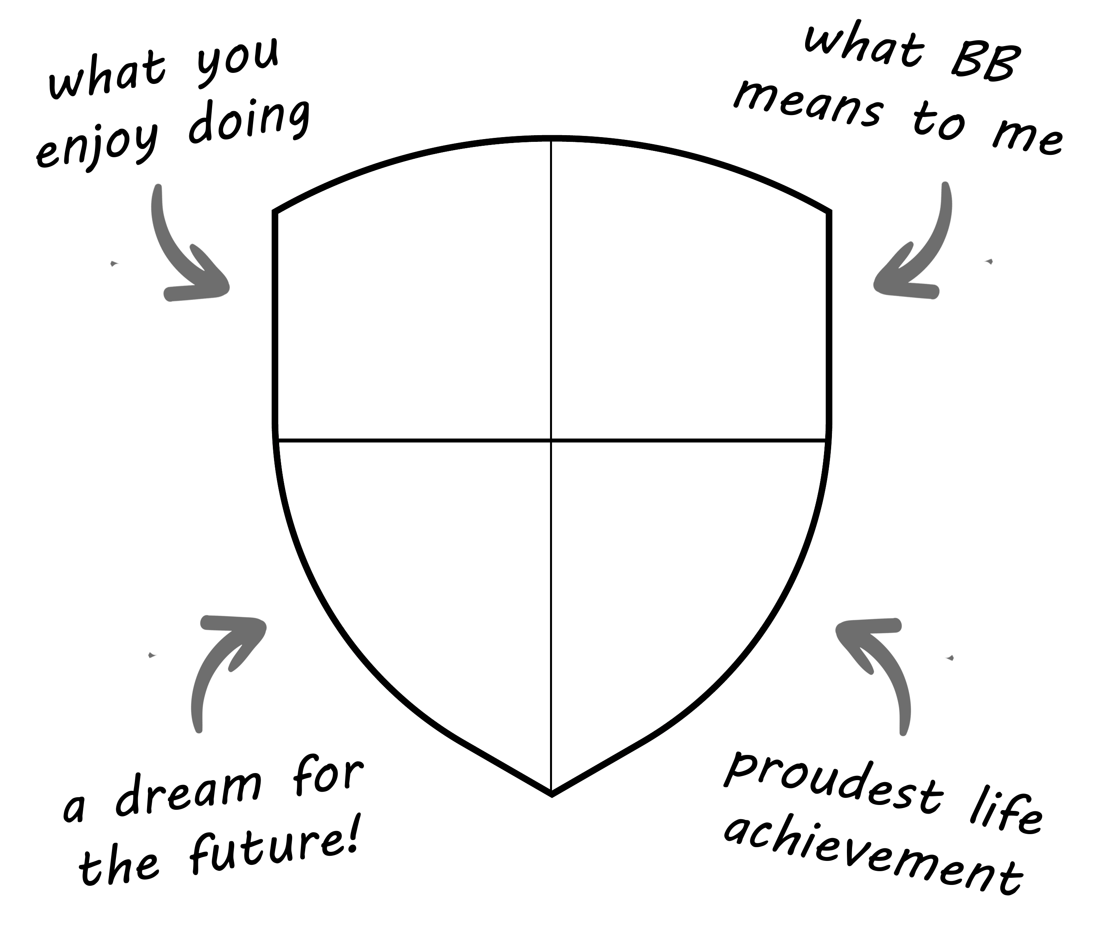
MY SHIELD ACTIVITY
An opportunity to get to know the group a little better.

Slide 7
MY SHIELD

Slide 9
MY JOURNEY
An opportunity to reflect on your journey to this point and appreciate the hard work and progress that has been made. Looking at your BB, Queen’s Badge and faith journeys.

Slide 10
MY BB JOURNEY
When did you first join The Boys’ Brigade?
Why / how did you join?
What has been your highlight or proudest achievement of your time in the BB?
Which part of the BB have you enjoyed the least?
If you could go back to the day you joined BB and give your younger self one piece of advice about their BB journey to come, what would you say?

Slide 11
MY QUEEN’S BADGE JOURNEY
What have you done for your Queen’s Badge? (volunteering, leadership, physical etc)
What has been the highlight of completing the Queen’s Badge?
Which area did you find the most challenging?
What can you take away from your Queen’s Badge experience that can be used in the future? (i.e a skill, increased confidence, knowing you can see things through etc).

Slide 12
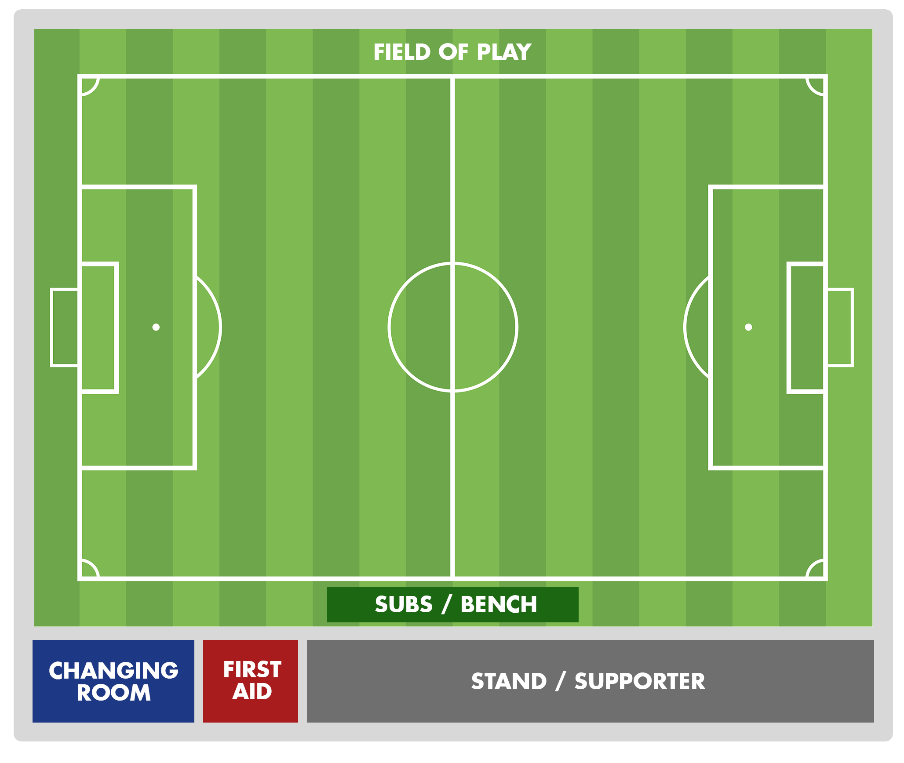
MY FAITH JOURNEY
Attack
Defence
Stand
Subs bench
Changing Room
First Aid
Outside

Slide 13
MY
FAITH
JOURNEY
Where are you on the field of play?
Attack
Defence
Stand
Subs bench
Changing Room
First Aid
Outside

Slide 15
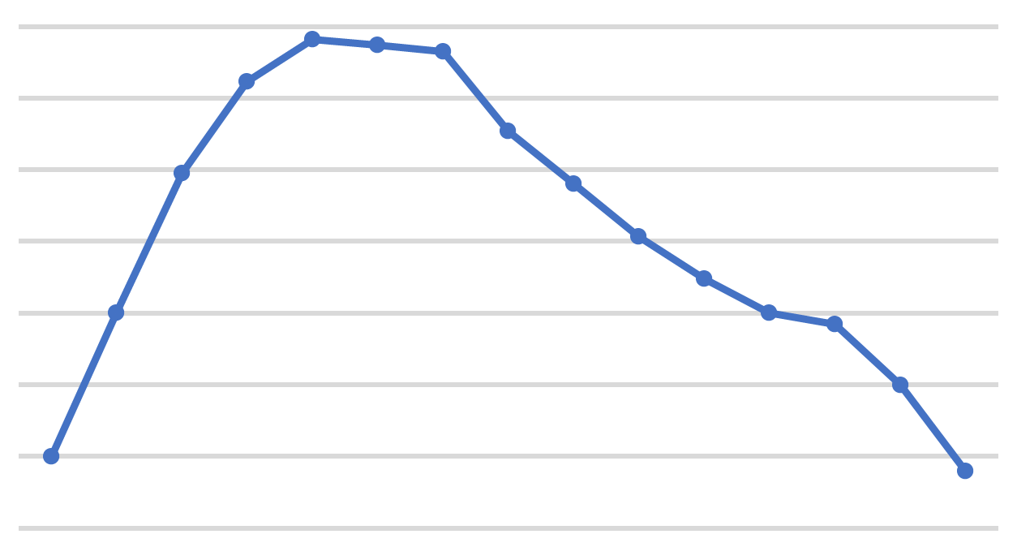
PROJECT: DRAGON’S DEN

Slide 16
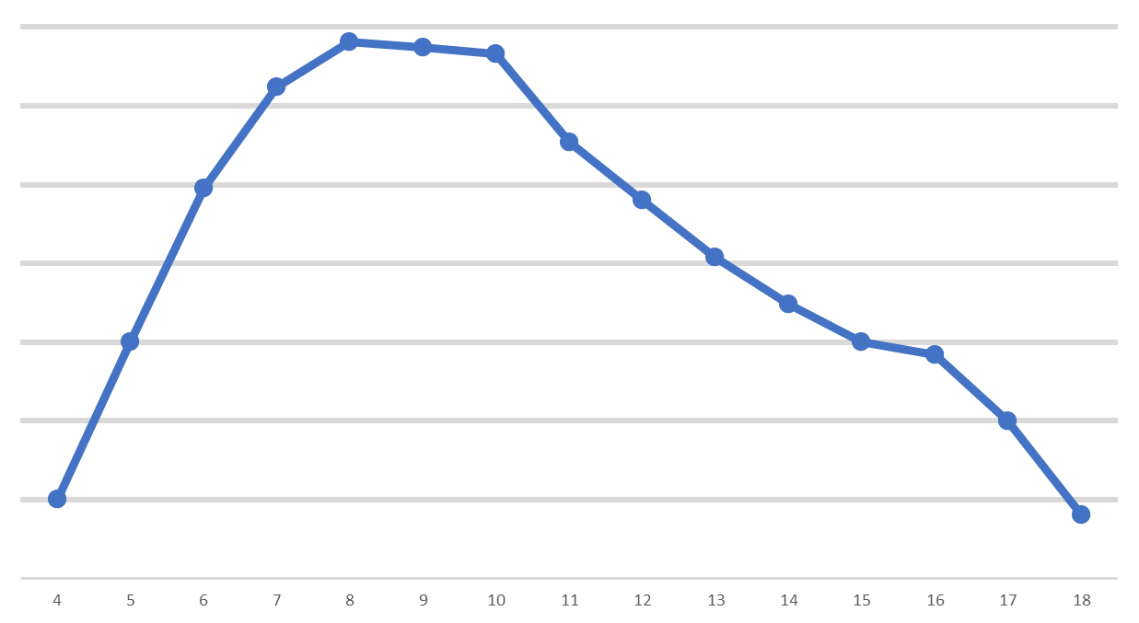
MEMBERSHIP OF THE BOYS’ BRIGADE BY AGE
NUMBER OF MEMBERS
AGE OF MEMBER

Slide 18
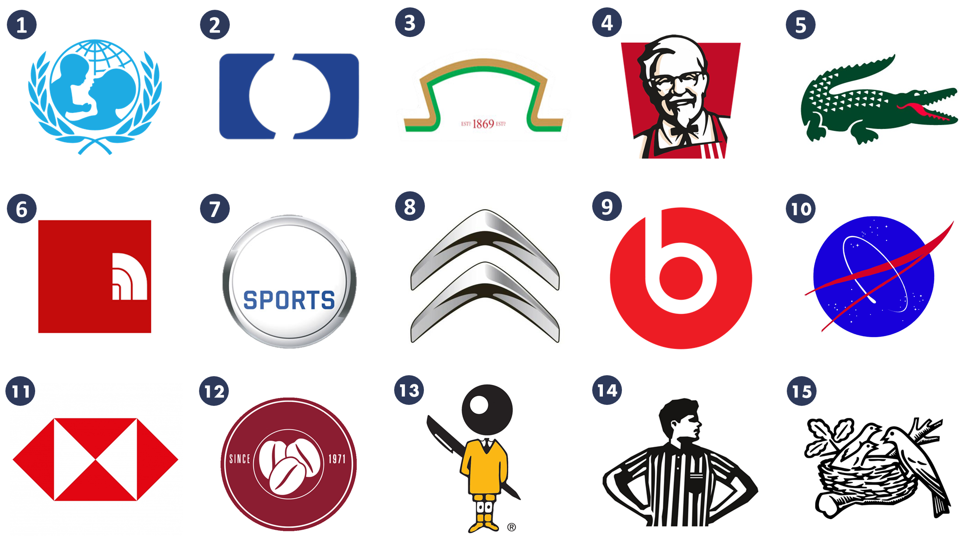
PROJECT: DRAGON’S DEN - BRAND
A look at different brands and the messages behind them. What is brand BB?

Slide 20
PROJECT: DRAGON’S DEN - BRAND
Answers:
UNICEF
HP
Heinz
KFC
Lacoste
North Face
EA Sports
8) Citroen
9) Beats
10) NASA
11) HSBC
12) Costa Coffee
13) Bic Pens
14) Footlocker
15) Nestle

Slide 21
WHAT ARE THE VALUES / MESSAGES / TARGET MARKETS?

Slide 22
WHAT IS ‘BRAND BB’? .
Key Words / Values / Message / Target Market

Slide 24
PROJECT: DRAGON’S DEN – SALES PITCH
Take the BB model and make any changes you wish, in order to present an improved / updated model you can pitch to the investors.

Slide 25
KEEPING
CHANGING
ACTIVITIES / PROGRAMME

Slide 26
KEEPING
CHANGING
VALUES / PURPOSE

Slide 27
KEEPING
CHANGING
STRUCTURE (AGES, GENDER, AGE GROUPS ETC)

Slide 28
WHEN A MEMBER COMPLETES THEIR TIME WITH OUR ORGANSIATION THEY WILL HAVE:
(What will they have experienced / had the opportunity to do / skills gained etc?)

Slide 30
RECAP ON TODAY’S OBJECTIVES
Reflect on your life experiences up to this point.
Think about the journey working towards the Queen’s Badge has taken you on.
Start to explore what you want from the future
Tick off the final requirement for the Queen’s badge
Meet and hear from other young people in a similar position to you
Have fun!

