Slide 1
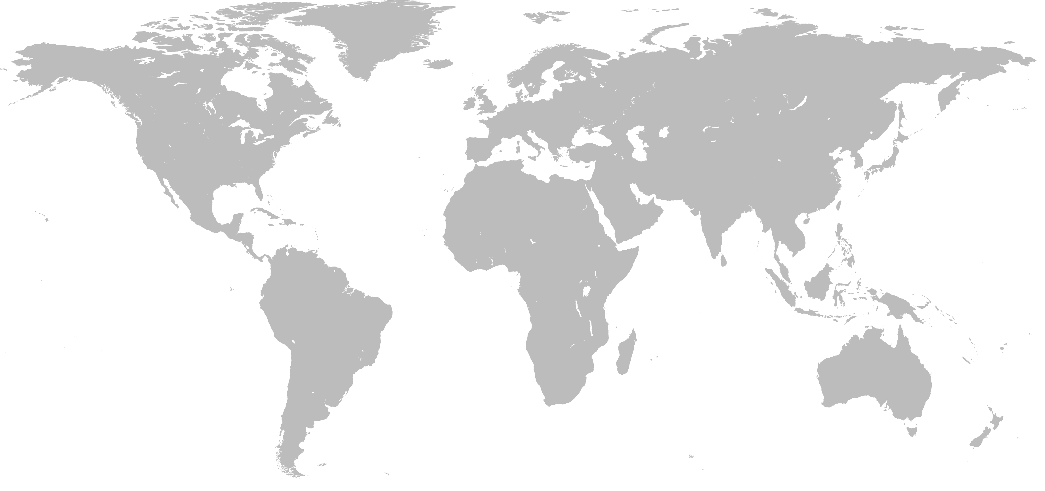
WHERE IN THE WORLD?

Slide 2
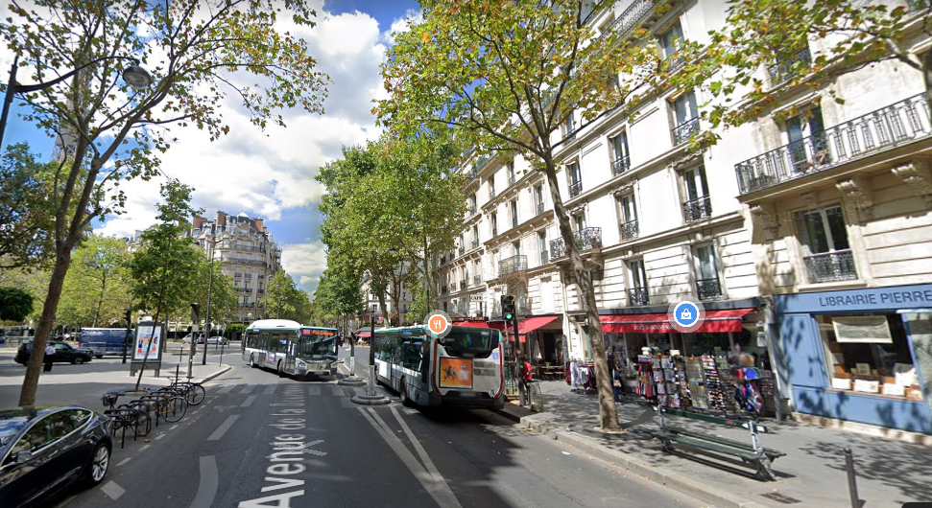

Slide 3
WHERE IN THE WORLD?
DRAW AN ‘X’ ON THE MAP FOR YOUR GUESS

Slide 4
WHERE IN THE WORLD?
ANSWER – PARIS, FRANCE

Slide 5
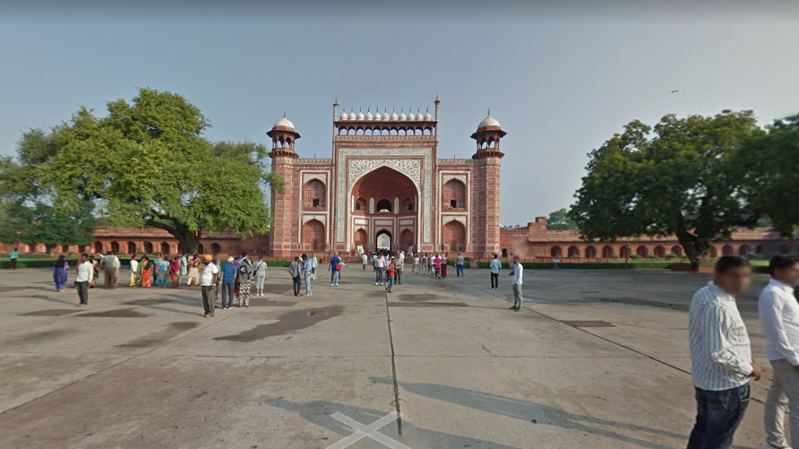

Slide 6
WHERE IN THE WORLD?
DRAW AN ‘X’ ON THE MAP FOR YOUR GUESS

Slide 7
WHERE IN THE WORLD?
ANSWER – TAJ MAHAL, INDIA

Slide 8
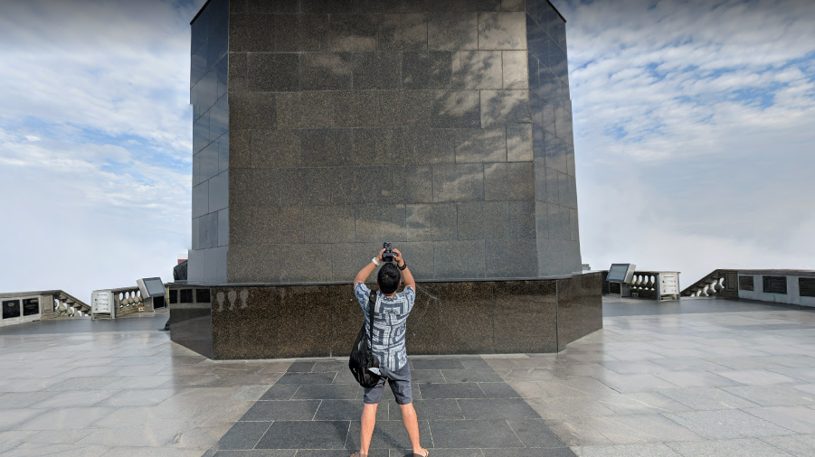

Slide 9
WHERE IN THE WORLD?
DRAW AN ‘X’ ON THE MAP FOR YOUR GUESS

Slide 10
WHERE IN THE WORLD?
ANSWER – CHRIST THE REDEEMER STATUE, RIO DE JANEIRO, BRAZIL

Slide 11
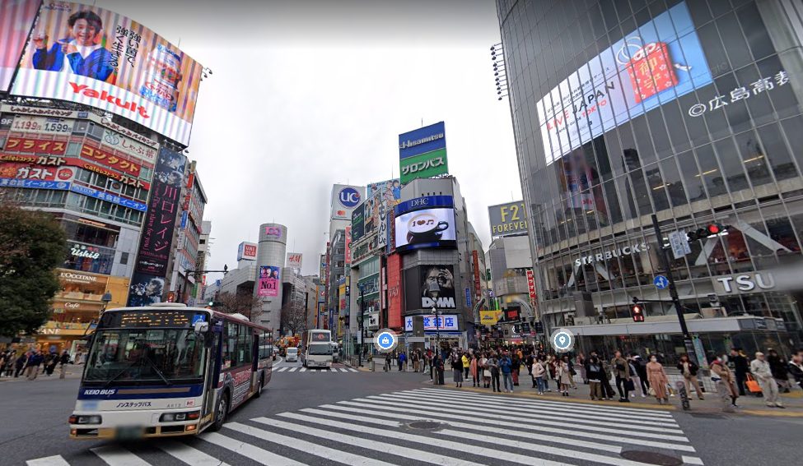

Slide 12
WHERE IN THE WORLD?
DRAW AN ‘X’ ON THE MAP FOR YOUR GUESS

Slide 13
WHERE IN THE WORLD?
ANSWER – TOKYO, JAPAN

Slide 14
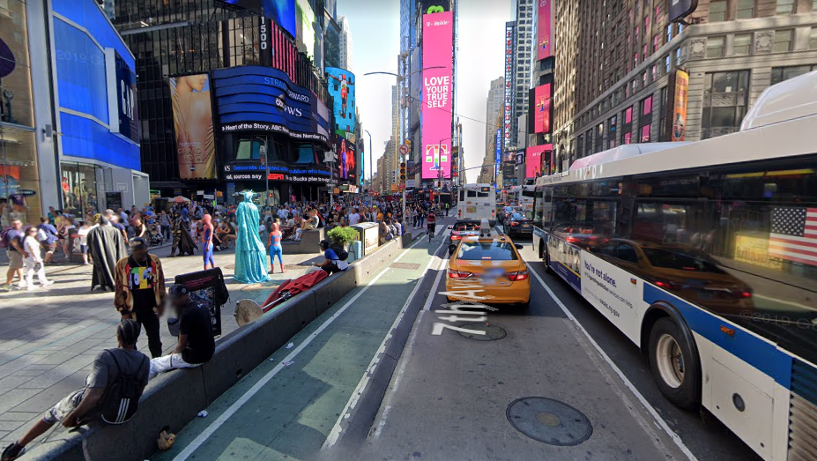

Slide 15
WHERE IN THE WORLD?
DRAW AN ‘X’ ON THE MAP FOR YOUR GUESS

Slide 16
WHERE IN THE WORLD?
ANSWER – NEW YORK, USA

Slide 17
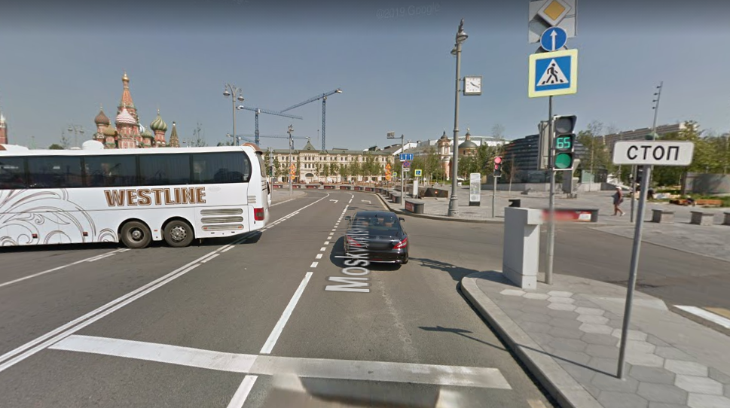

Slide 18
WHERE IN THE WORLD?
DRAW AN ‘X’ ON THE MAP FOR YOUR GUESS

Slide 19
WHERE IN THE WORLD?
ANSWER – MOSCOW, RUSSIA

Slide 20
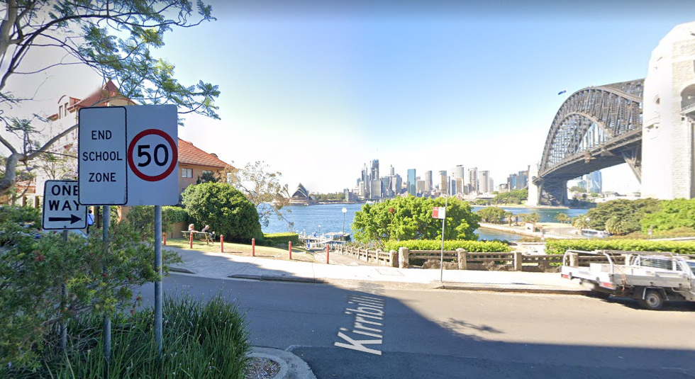

Slide 21
WHERE IN THE WORLD?
DRAW AN ‘X’ ON THE MAP FOR YOUR GUESS

Slide 22
WHERE IN THE WORLD?
ANSWER – SYDNEY, AUSTRALIA

Slide 23
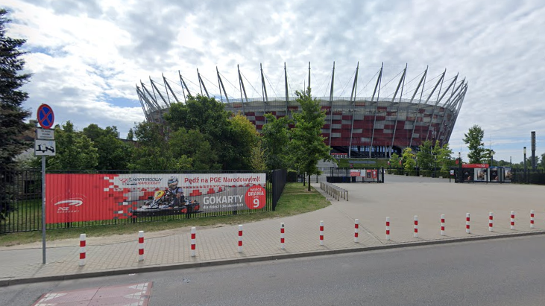

Slide 24
WHERE IN THE WORLD?
DRAW AN ‘X’ ON THE MAP FOR YOUR GUESS

Slide 25
WHERE IN THE WORLD?
ANSWER – WARSAW, POLAND

Slide 26
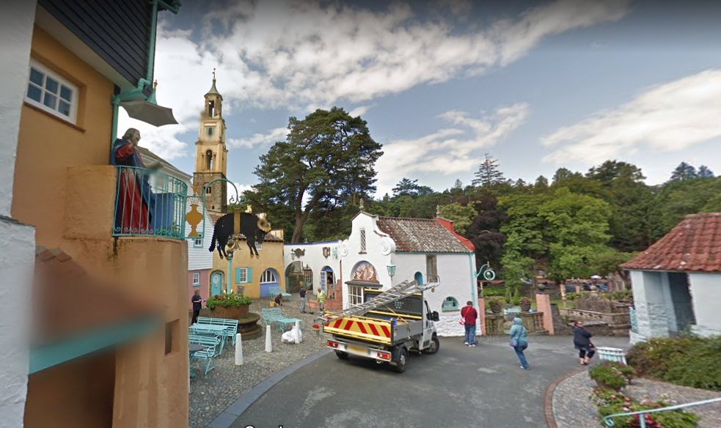

Slide 27
WHERE IN THE WORLD?
DRAW AN ‘X’ ON THE MAP FOR YOUR GUESS

Slide 28
WHERE IN THE WORLD?
ANSWER – PORTMEIRION, WALES, UK

Slide 29
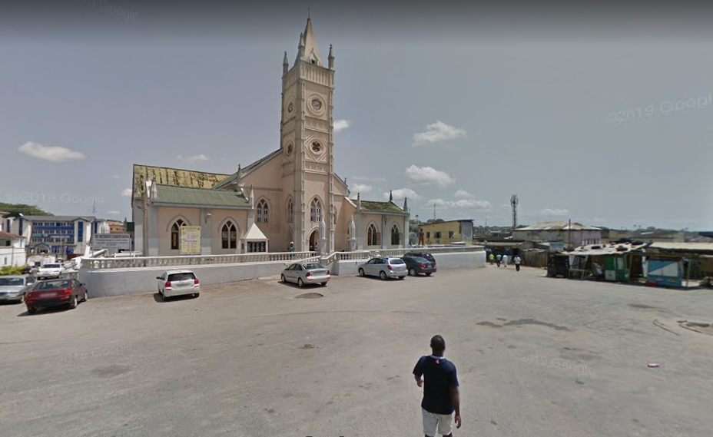

Slide 30
WHERE IN THE WORLD?
DRAW AN ‘X’ ON THE MAP FOR YOUR GUESS

Slide 31
WHERE IN THE WORLD?
ANSWER – CAPE COAST, GHANA

