Slide 1
A Question of Sport

Slide 2
Round 1:
Sports General knowledge

Slide 3
Question 1:
Who won the Premier League’s Golden Boot (most goals scored) for the 2019/20 season?
Round 1 – Sport General Knowledge

Slide 4
Question 2:
What Colours are the 5 Olympic rings?
Round 1 – Sport General Knowledge

Slide 5
Question 3:
Name the four Grand Slam events in tennis?
Round 1 – Sport General Knowledge

Slide 6
Question 4:
What is the total of:
Players in a football team
Maximum score in darts (3 throws)
Value of the black ball in snooker
Number of miles in a marathon
Round 1 – Sport General Knowledge

Slide 7
Question 5:
What major sporting event takes place at Aintree each April?
Round 1 – Sport General Knowledge

Slide 8
Question 6:
Which sport includes the terms ‘house’ and ‘hammer’ and equipment called ‘stones’ and ‘brooms’?
Round 1 – Sport General Knowledge

Slide 9
Question 7:
Which team does Lewis Hamilton drive for in F1?
Round 1 – Sport General Knowledge

Slide 10
Question 8:
Which country’s rugby team is called the Springboks?
Round 1 – Sport General Knowledge

Slide 11
Question 9:
True or False? Skateboarding was due to make its Olympic debut at the Tokyo 2020 Games?
Round 1 – Sport General Knowledge

Slide 12
Question 10:
In bowling, what is the name given for achieving three consecutive strikes?
Round 1 – Sport General Knowledge

Slide 13
Round 1:
Sports General knowledge
Answers

Slide 14
Sport General Knowledge Answers
Jamie Vardy (Leicester City FC)
Red, Yellow, Blue, Green, Black
Australian Open, French Open, Wimbledon, US Open
11 + 180 + 7 + 26 = 224
Grand National (Horse Racing)
Curling
Mercedes
South Africa
True
Turkey

Slide 15
Round 2:
Famous Sporting Faces

Slide 16
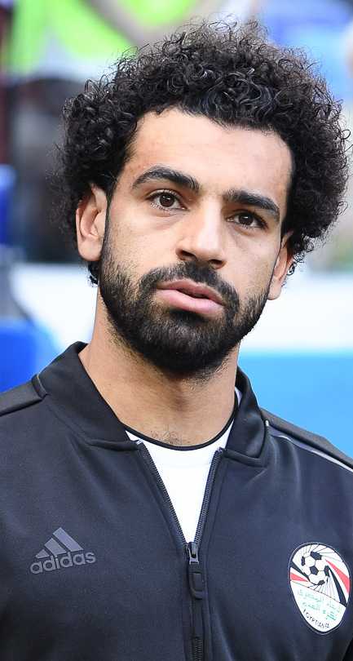
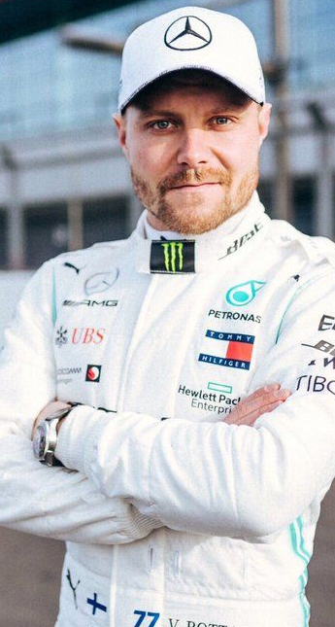
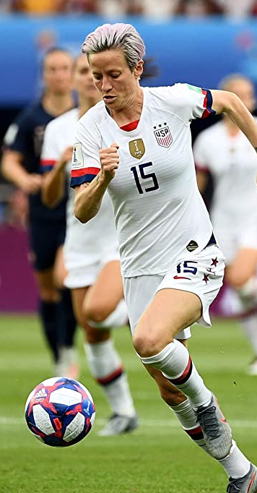
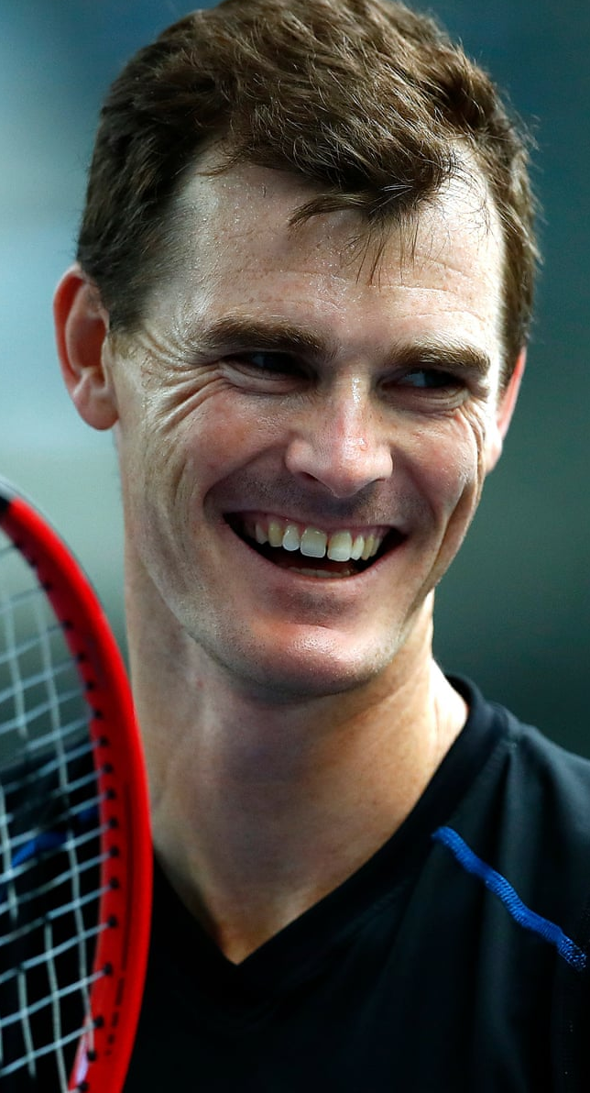

Slide 17
Famous Sporting Faces Answers
Mo Salah
Valtteri Bottas
Novak Djokovic
Alex Scott
Harry Kane
Owen Farrell
Anthony Joshua
Megan Rapinoe
Jamie Murray
Joe Root

Slide 18
Round 3:
Name the stadium/Ground/Venue

Slide 19
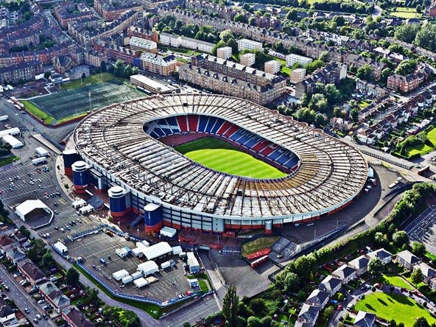
1

Slide 20
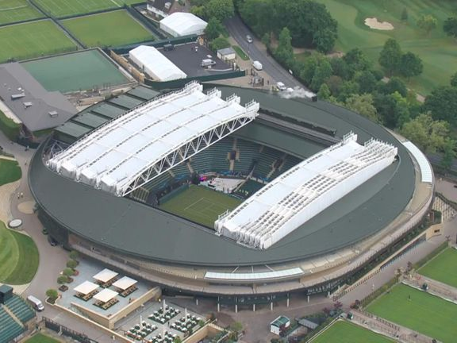
2

Slide 21
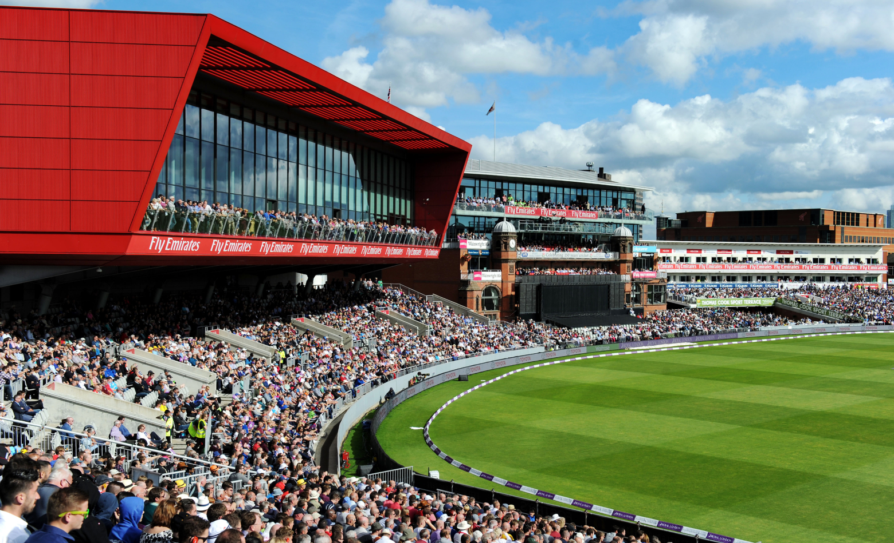
3

Slide 22
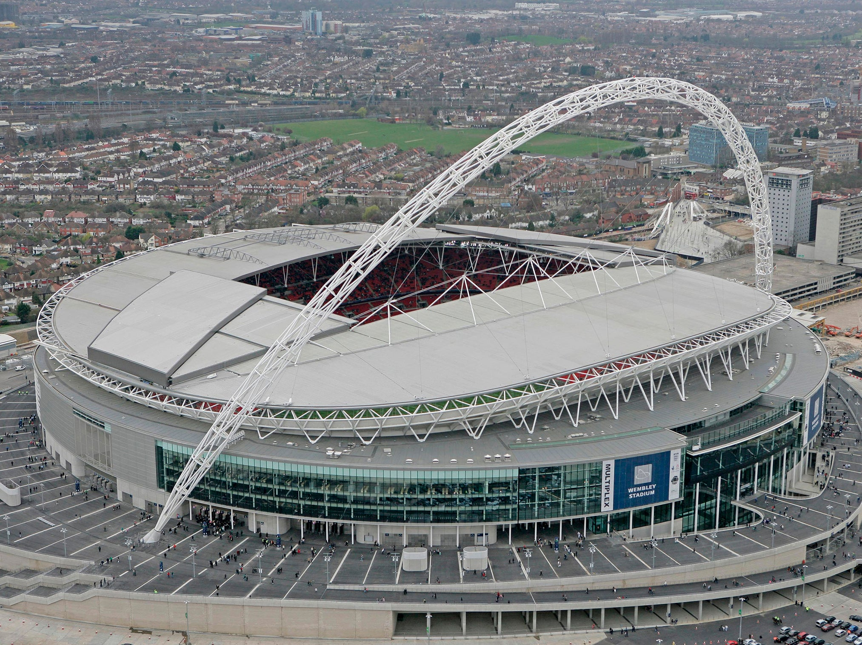
4

Slide 23
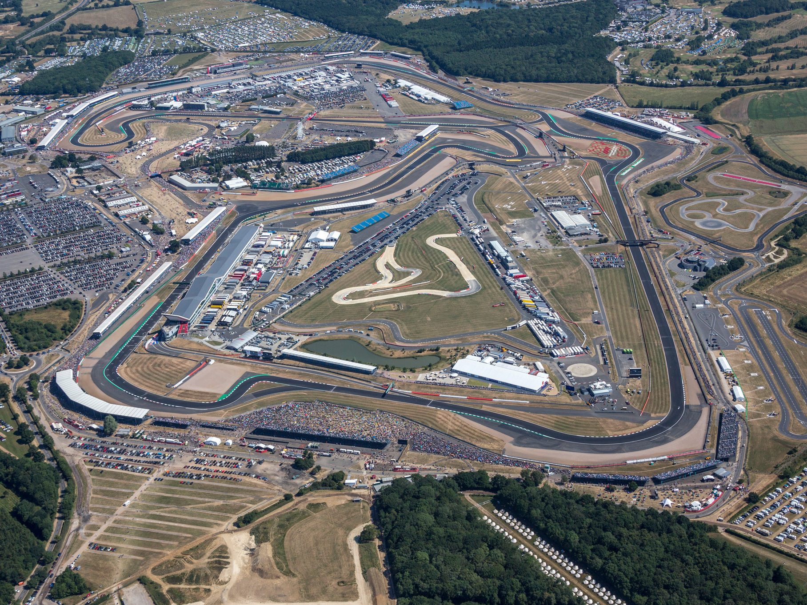
5

Slide 24
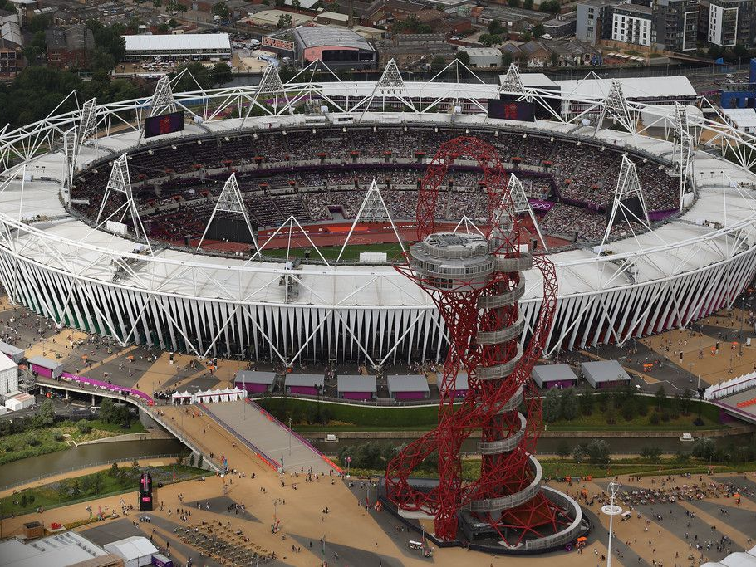
6

Slide 25
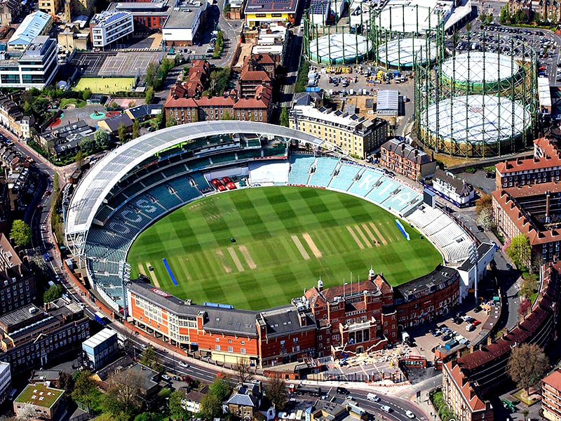
7

Slide 26
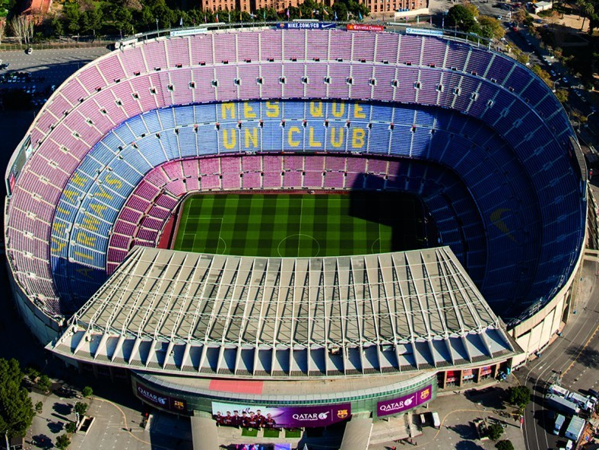
8

Slide 27
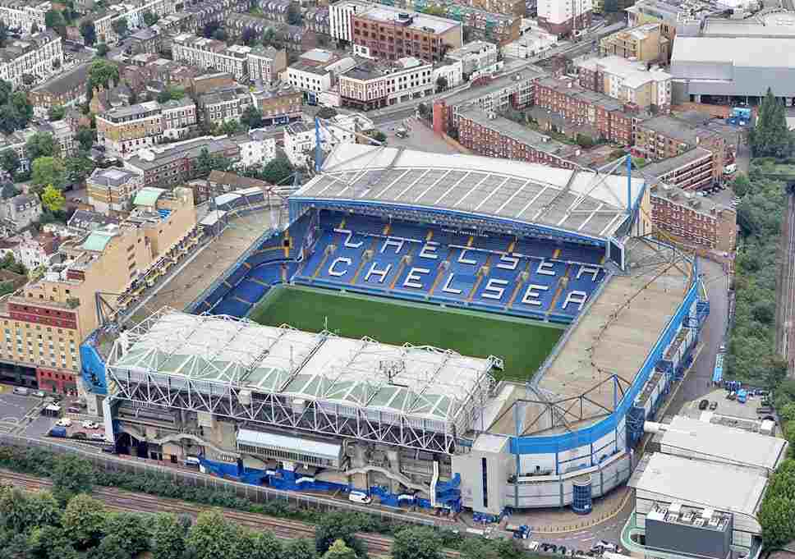
9

Slide 28
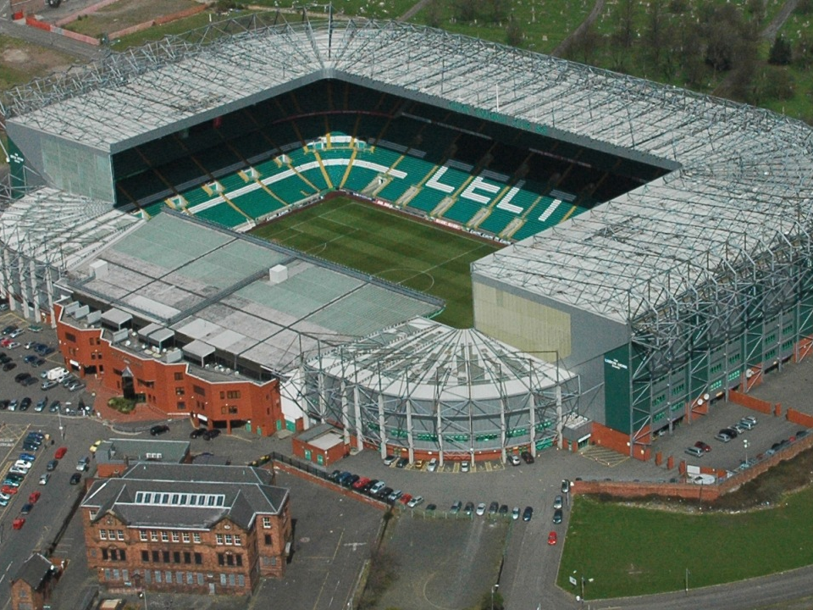
10

Slide 29
Round 3:
Name the stadium/Ground/Venue Answers

Slide 30
Name the stadium/Ground/Venue Answers
Hampden Park
Centre Court (Wimbledon)
Old Trafford Cricket Ground
Wembley
Silverstone Circuit
Olympic Stadium / London Stadium
The Oval
Camp Nou (Barcelona)
Stamford Brigade (Chelsea)
Celtic Park (Celtic)

