Slide 2
LEARNING OUTCOMES
At the end of this session participants will be able to:
Understand Safeguarding and Child Protection in the context of your role within The Boys’ Brigade
Know how to Recognise, Respond to, Report and Record concerns about a child or young person

Slide 3
YOUR SAFEGUARDING TIMELINE
When was the last time you did any safeguarding training?
In the past 2 years ?
In the past 5 years?
Never?

Slide 4
YOUR SAFEGUARDING TIMELINE
How confident are you in dealing with a safeguarding referral ?
Very confident – I know the policies, I know what to do and who to inform
Fairly confident – I know what to do and when but might need help withy the process
Not very confident – I would rather someone else did it
Not at all confident – I do not know what I would need to do

Slide 5
E-LEARNING RECAP
“Safeguarding is the measures and actions that are taken to promote the welfare of children & young people and protect them from harm”
WHOLE GROUP ACTIVITY: Questions . . .

Slide 6
E-LEARNING RECAP
What does the BB do to ensure ‘Safer recruitment’ of leaders?

Slide 7
SAFER RECRUITMENT
Our safer recruitment policy is about ensuring ‘suitable’ leaders are appointed through . . .
Recommendations
Vetting & Barring
ID Verification
References
Training

Slide 8
E-LEARNING RECAP
What Training & Development is provided for leaders?

Slide 9
TRAINING & DEVELOPMENT
We have a culture of on-going training and development, this includes . . .
Mandatory e-learning modules
Youth Leader Training (YLT)
Refresher & Other Themed Training
Training as required by local Church

Slide 10
E-LEARNING RECAP
What is the Leaders Code of Conduct?

Slide 11
LEADERS CODE OF CONDUCT
Outlines the expectations we have of our leaders in relation to their behaviours and actions, including:
Responsibilities
Relationships & Boundaries
Expected Good Practice
Unacceptable Behaviour

Slide 12
E-LEARNING RECAP
What policies, procedures, and guidance do we have and where can you find these?

Slide 13
POLICIES & GUIDANCE
Safer Recruitment
Safeguarding Policy
Leader Code of Conduct
Good Practice Guidance
Position of Trust Guidance
Guidance for Leaders facing safeguarding concerns/allegations
Whistleblowing Policy
Find online at boys-brigade.org.uk/safeguarding/

Slide 14
E-LEARNING RECAP
Child Protection – What does this mean?

Slide 15
CHILD PROTECTION – WHAT DOES THIS MEAN?
This a part of safeguarding.
It is the actual action and processes we undertake to protect individual children or young people we suspect have suffered or are suffering harm.

Slide 16
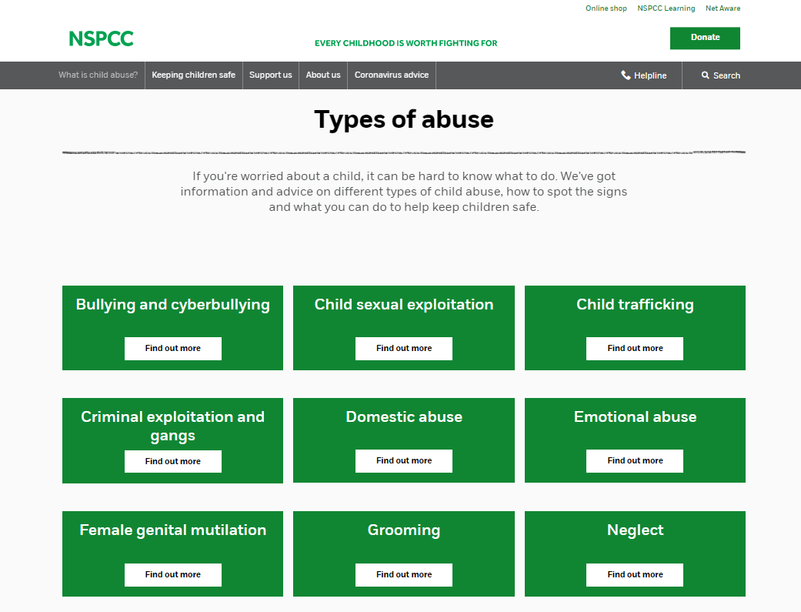
RECOGNISING HARM & ABUSE
SMALL GROUP ACTIVITY: Recognising Harm & Abuse
Visit nspcc.org.uk
Was there a type of harm you were unaware of?
Is there anything you would struggle with? Would you feel uncomfortable hearing about some of these?
Is there anything you don’t understand?
Are there any words you might find hard to say when “passing it on?”

Slide 17
HOW PREVALENT IS CHILD ABUSE IN THE UK?
1 in 5 adults experienced at least one form of child abuse / 8.5m people
An estimated 3.1 million adults aged 18 to 74 years were victims of sexual abuse before the age of 16 years
Around half of adults (52%) who experienced abuse as a child also experienced domestic abuse later in life, compared with 13% of those who did not experience abuse as a child
Crime Survey for England and Wales 2019

Slide 18
THE 4 R’s - RECOGNISING
SMALL GROUP ACTIVITY: Case Studies
In groups consider each statement:
On a scale of 1–10 (10 = greatest) rank case study based on how much harm is being caused to the child.
Try to reach an agreement about the ranking and note down any reasons if you disagree.

Slide 19
THE 4 R’s
Things to consider:
Has the child/young person been abused/harmed?
What type of harm/abuse is this?
Has a crime been committed?
What are you going to do?
Remember to rank each case study on a scale of 1 – 10 (10 = greatest)

Slide 20
CASE STUDY 1
You are a leader in your Company. One of the young people attends BB with a mark on his face. He tells you his teaching assistant did it at school today. He hasn’t told his parents as they were busy earlier, and did not notice the mark.

Slide 21
CASE STUDY 1
The Law Currently
England and Northern Ireland
It is unlawful to assault a child?
There is a defence of reasonable punishment, only if you are the parent/carer. This defence can only be used if:
There is no lasting mark
The circumstances are reasonable
Section 58 Children Act 2004
Republic of Ireland - On 11th December 2015 the reasonable punishment defence was abolished. Children First Act 2015
Wales - The Welsh Assembly agreed to remove the reasonable punishment defence, and this became law on 21st March 2022. Children Act 2020
Scotland - In 2017 the Government agreed to consider banning smacking. Legislation was agreed in October 2019. This became law in November 2020. Children (Equal protection from Assault) Scotland Act 2019
Notes:
Recognise, Report, Record – do you know who your Safeguarding Coordinator is?

Slide 22
CASE STUDY 2
You are the Leader-in-Charge for Juniors. A parent has contacted you and stated their child was kicked by a leader last week and they have reported it to the police today. Your Company meets tomorrow night.

Slide 23
CASE STUDY 3
An Anchor always comes to BB late. They often do not have the correct uniform. They look scruffy, and sometimes appear smelly and unwashed. You notice other children make fun of them.

Slide 24
“1 in 10 children have experienced neglect”
NEGLECT - NSPCC
Neglect can be a lot of different things, which can make it hard to spot. But broadly speaking, there are 4 types of neglect:
PHYSICAL - A child's basic needs, such as food, clothing or shelter, are not met or they aren’t properly supervised or kept safe.
EDUCATIONAL - A parent doesn't ensure their child is given an education.
EMOTIONAL - A child doesn't get the nurture and stimulation they need. This could be through ignoring, humiliating, intimidating or isolating them.
MEDICAL - A child isn't given proper health care. This includes dental care and refusing or ignoring medical recommendations.
Signs of neglect can be really difficult to spot. Having one of the signs doesn't necessarily mean a child is being neglected. But if you notice multiple signs that last for a while, they might show there's a serious problem.
Notes:
Skip this slide if struggling with time

Slide 25
CASE STUDY 4
You are the Captain. One of your leaders has just informed you about a “relationship” between two people in your Company, one of which is a female leader aged 18. The young person is a male aged 16 (nearly 17).

Slide 26
CASE STUDY 4
In terms of ‘Position of Trust’:
Current legislation (laws)
Legislation is being expanded
Regional variations
BB guidance for leaders
You can find our ‘Position of Trust’ guidance at boys-brigade.org.uk/position-of-trust/

Slide 27
CASE STUDY 5
You recently become a leader after helping at your local BB group for a year. You have just completed the YLT Safeguarding Module and realised that some things in your Company are not done correctly. Helpers attend for several weeks/months, before they complete leader registration processes. Leaders often join in football and other contact games. You spoke about the training to your Captain. He explained that we need to see how helpers fit in before they join properly, and some of the rules are ignored because they don’t work for our Company.

Slide 28
LEADERS CODE OF CONDUCT
Outlines the expectations we have of our leaders in relation to their behaviours and actions, including:
Responsibilities
Relationships & Boundaries
Expected Good Practice
Unacceptable Behaviour
You can find the ‘Leaders Code of Conduct’ at boys-brigade.org.uk/safeguarding/

Slide 29
CASE STUDY OVERVIEW
How hard was it to agree the level of harm?
What helps us make a decision?
Is there always a correct answer?
How do we get it right?

Slide 30
THE 4 R’s - RESPONDING
How might you respond to a concern raised by a child/young person?
SMALL GROUP ACTIVITY: Responding to Concerns

Slide 31
Report what the child has told you as soon as possible in line with your CP Procedures, and Church procedures
Reassure them -
Let them know they've done the right thing by telling you
Listen carefully to what they're saying / Be sensitive, arrange a safe environment to talk
RESPONDING
How might you respond ?
Take any allegation seriously
Never promise to keep secrets
Don’t discuss with or confront the alleged abuser
Explain what you'll do next – Be honest, don’t make promises you can’t keep

Slide 32
BARRIERS TO RESPONDING
What might prevent a leader responding appropriately and not reporting an allegation?
SMALL GROUP ACTIVITY: Barriers to responding
Notes:
In your break out rooms spend 5 minutes thinking about this - add to chat / flip chart page

Slide 33
THE 4 R’s - RESPONDING
An allegation or concern is often made unexpectantly.
Plan now . . .
Know where to find the BB Safeguarding Procedures. Have a read of them.
Find out who your Church Safeguarding Lead/Co-ordinator is.
Know where to find your Church Safeguarding Policy and read it.
Ensure you have contact numbers for your Captain, Chaplain, BBHQ Safeguarding Manager (0300 303 4454 or safeguarding@boys-brigade.org.uk). Put it in your phone now!

Slide 34
Report as soon as possible, always within 24 hours
THE 4 R’s – REPORTING (PASS IT ON)
Non Emergency
Emergency
Minister
Other Church official / safeguarding lead
BBHQ Safeguarding Manager
Captain
Chaplain
999

Slide 35
REPORTING – REGIONAL DIFFERENCES
In non urgent circumstances BBHQ Safeguarding Manager will take responsibility for referring to Statutory Agencies.
E&W – Police, Social Services – Lado/Mash, Police, NSPCC, Childline
Northern Ireland - Police, PSNI, NSPCC , Health and Social Trust Gateway
ROI - Police, Tusla – Child and family agency
Scotland - Police, NSPCC, Local Social work team, Children’s reporter

Slide 36
THE 4 R’s - RECORDING
You should . . .
Write down what was said as soon as possible.
Detail who the concern is about, what the concern is and what happened.
Use the child/young person’s words - include any questions that were asked, and the answers given.
As a leader, write down anything you have seen or heard, including details of any witnesses. Include who you have spoken to, when, and include their contact details.
Include any history about the child/young person or family that could be relevant.
Complete your report as soon as possible after the event.

Slide 37
CAN WE ASK QUESTIONS?
Necessary – to establish whether or not there is a concern.
Non leading - don’t suggest an answer.
Open – Avoid questions that invite only YES or NO answers.
Use TED:
TELL ME
EXPLAIN
DESCRIBE

Slide 38
TELL ME WHAT HAPPENED
“I was on a school trip, at the park and fell off the climbing frame. Miss was amazing. She grabbed me and stopped me landing on the floor. Her nail caught my face. My head would have have exploded if I hit the deck.
Child
“I pushed a girl over in the play ground. Miss grabbed my arm and dragged me to the time out area. My head banged on the door as we went inside. She was really cross with me. I made the girl cry.
Child
You now have enough information and an understanding of what has happened.

Slide 39
YOUR ACCOUNT
“I am Leader-in-Charge for Juniors with 1st Anywhere Company. On Monday 15th October we were designing posters for our fundraising event. The young people were at tables in groups of 4. I saw JP had a mark on his face. The mark was across his cheek bone, and under his eye area. It looked red in appearance. I asked him “How did that happen” He said “My teacher did it”. I then asked “Tell me what happened?”. He said “I pushed a girl over in the playground. Miss grabbed my arm and dragged me to the time out area. My head banged on the door handle as we went inside. She was really cross with me. I made the girl cry.
During the snack break I spoke to the Captain and told him what had happened. He told me he would take responsibility for this. He asked me to make notes of what JP said and asked me to write this account straight away. JP has been with us for 2 years. He lives with his parents and younger brother. He attends Anywhere Primary School.”
Signed ………….dated ……….
Notes:
By adding extra details, such as what you were doing it will help with “refreshing your memory” if this is referred to in the future, such as in Criminal Proceedings.

Slide 40
ONLINE REPORTING FORM
The best way to report a safeguarding concern or allegation is to use our online reporting form at boys-brigade.org.uk/safeguarding/
Notes:
This will soon be available.
Anyone can use it
It is ok for me to receive more than one report.

Slide 41
YOUR ROLE
We can all play a part in keeping children safe.
Remember:
Safeguarding is everyone’s responsibility.
The 4 R’s – Recognise, Respond, Report & Record.
Always maintain appropriate boundaries with children & young people.
Regularly familiarise yourself with our latest polices and procedures.
If any doubt, seek advice!
ALWAYS inform BBHQ Safeguarding Manager of any safeguarding concern about a BB Volunteer or young person as soon as possible, but always within 24 hours.
safeguarding@boys-brigade.org.uk or 0300 303 4454

Slide 42
YOUR SAFEGUARDING TIMELINE
How confident are you now, in dealing with a safeguarding referral ?
Very confident – I know the policies, I know what to do and who to inform
Fairly confident – I know what to do and when but might need help with the process
Not very confident – I would rather someone else did it
Not at all confident – I do not know what I would need to do

Slide 43
LEARNING OUTCOMES
At the end of this session participants will be able to:
Understand Safeguarding and Child Protection in the context of your role within The Boys’ Brigade
Know how to Recognise, Respond to, Report and Record concerns about a child or young person.

