Slide 1


Slide 2


LEARNING OUTCOMES
At the end of this session participants will be able to:
Understand Safeguarding and Child Protection in the context of your role within The Boys’ Brigade
Know how to Recognise, Respond to, Report and Record concerns about a young person

Slide 3
YOUR SAFEGUARDING TIMELINE
When was the last time you did any safeguarding training?
In the past 2 years ?
In the past 5 years?
Never?

Slide 4
YOUR SAFEGUARDING TIMELINE
How confident are you in dealing with a safeguarding referral ?
Very confident – I know the policies, I know what to do and who to inform
Fairly confident – I know what to do and when but might need help withy the process
Not very confident – I would rather someone else did it
Not at all confident – I do not know what I would need to do

Slide 5
E-LEARNING RECAP
“Safeguarding is the measures and actions that are taken to promote the welfare of children and protect them from harm”
WHOLE GROUP ACTIVITY: Questions . . .

Slide 6
E-LEARNING RECAP
What does the BB do to ensure ‘Safer recruitment’ of leaders?

Slide 7
SAFER RECRUITMENT
BB and Church of Scotland (CoS) Safer Recruitment Processes are designed to ensure only suitable leaders are appointed. They include:
CoS Application form AND BB LREG1a form
Interview
Two references
Protecting Vulnerable Groups (PVG) membership scheme
Approval by Kirk Session
And, since 2022, completion of BB Mandatory eLearning Modules
…all before they start in post.

Slide 8
E-LEARNING RECAP
What Training & Development is provided for leaders?

Slide 9
TRAINING & DEVELOPMENT
We have a culture of on-going training and development, this includes . . .
Mandatory e-learning modules
Youth Leader Training (YLT)
Refresher & Other Themed Training
Training as required by local Church

Slide 10
E-LEARNING RECAP
What is the Leaders Code of Conduct?

Slide 11
LEADERS CODE OF CONDUCT
Outlines the expectations we have of our leaders in relation to their behaviours and actions, including:
Responsibilities
Relationships & Boundaries
Expected Good Practice
Unacceptable Behaviour

Slide 12
E-LEARNING RECAP
What policies, procedures, and guidance do we have and where can you find these?

Slide 13

Some of our Policies and Guidance
  Safeguarding Policy Statement
  Safer Recruitment
  Whistleblowing Policy
  Leaders Code of Conduct
  Good Practice Guidance
  Position of Trust Guidance
  Guidance for Leaders facing safeguarding
  concerns/allegations
Find online at boys-brigade.org.uk/safeguarding/
COS Safeguarding Policies and guidance can be found online at
churchofscotland.org.uk/about-us/safeguarding-service

Slide 14
THE SAFEGUARDING ACT - CHURCH OF SCOTLAND
Provides a framework to guide the Church’s response when a concern is raised
Includes safer recruitment, responsibilities of Presbyteries, Kirk Session, Safeguarding Co-ordinator and the Safeguarding Service
Outlines requirements for training, record keeping and retention
Advice given by the Safeguarding Service, when framed as an instruction, must be followed.

Slide 15
CHILD PROTECTION – WHAT DOES THIS MEAN?
This a part of safeguarding.
It is the actual action and processes we undertake to protect individual children we suspect have suffered or are suffering harm.

Slide 16
DEFINITION OF CHILD & ADULT AT RISK
In Scotland…
A child is a person under the age of 18 years for most safeguarding legislation, policies and guidance.
An “adult at risk” is a person over the age of 16 that you suspect or know is being harmed or exploited by another person, or is harming themselves, and is unable to protect themselves.

Slide 17
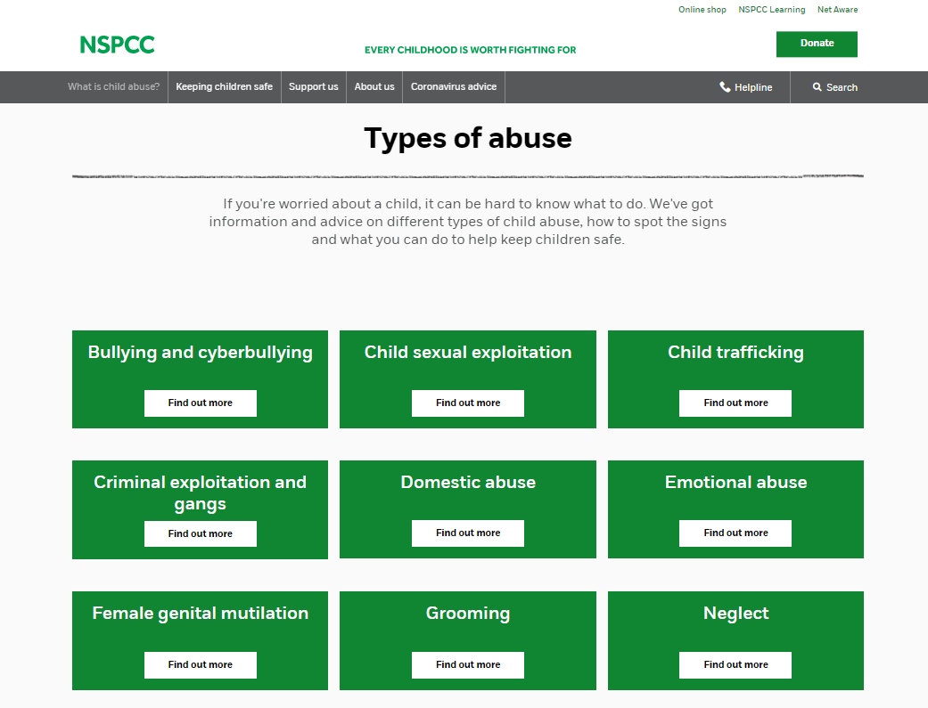
RECOGNISING HARM & ABUSE
SMALL GROUP ACTIVITY:
Recognising Harm & Abuse
Visit nspcc.org.uk
Was there a type of harm you were unaware of?
Is there anything you would struggle with? Would you feel uncomfortable hearing about some of these?
Is there anything you don’t understand?
Are there any words you might find hard to say when “passing it on?”

Slide 18
HOW PREVALENT IS CHILD ABUSE IN THE UK?
1 in 5 adults experienced at least one form of child abuse / 8.5m people
An estimated 3.1 million adults aged 18 to 74 years were victims of sexual abuse before the age of 16 years
Around half of adults (52%) who experienced abuse as a child also experienced domestic abuse later in life, compared with 13% of those who did not experience abuse as a child
Crime Survey for England and Wales 2019
Notes:
Similar statistics in Scotland.

Slide 19
THE 4 R’s - RECOGNISING
SMALL GROUP ACTIVITY:
Case Studies
In groups consider each statement:
On a scale of 1–10 (10 = greatest) rank case study based on how much harm is being caused to the child.
Try to reach an agreement about the ranking and note down any reasons if you disagree.

Slide 20
THE 4 R’s
Things to consider:
Has the child/young person been abused/harmed?
What type of harm/abuse is this?
Has a crime been committed?
What are you going to do?
Remember to rank each case study on a scale of 1 – 10 (10 = greatest)

Slide 21
CASE STUDY 1
You are a leader in your Company. One of the young people attends BB with a mark on his face. He tells you his teaching assistant did it at school today. He hasn’t told his parents as they were busy earlier, and did not notice the mark.

Slide 22
CASE STUDY 1
The Law Currently
England and Northern Ireland
It is unlawful to assault a child?
There is a defence of reasonable punishment, only if you are the parent/carer. This defence can only be used if:
There is no lasting mark
The circumstances are reasonable
Section 58 Children Act 2004
Republic of Ireland - On 11th December 2015 the reasonable punishment defence was abolished. Children First Act 2015
Wales - The Welsh Assembly agreed to remove the reasonable punishment defence, and this became law on 21st March 2022. Children Act 2020
Scotland - In 2017 the Government agreed to consider banning smacking. Legislation was agreed in October 2019. This became law in November 2020. Children (Equal protection from Assault) Scotland Act 2019
Notes:
Recognise, Report, Record – do you know who your Safeguarding Coordinator is?

Slide 23
CASE STUDY 2
You are the OIC for Juniors. A parent has contacted you and stated their child was kicked by a leader last week and they have reported it to the police today. Your Company meets tomorrow night.

Slide 24
CASE STUDY 3
An Anchor always comes to BB late. They often do not have the correct uniform. They look scruffy, and sometimes appear smelly and unwashed. You notice other children make fun of them.

Slide 25
“1 in 10 children have experienced neglect”
NEGLECT - NSPCC
Neglect can be a lot of different things, which can make it hard to spot. But broadly speaking, there are 4 types of neglect:
PHYSICAL - A child's basic needs, such as food, clothing or shelter, are not met or they aren’t properly supervised or kept safe.
EDUCATIONAL - A parent doesn't ensure their child is given an education.
EMOTIONAL - A child doesn't get the nurture and stimulation they need. This could be through ignoring, humiliating, intimidating or isolating them.
MEDICAL - A child isn't given proper health care. This includes dental care and refusing or ignoring medical recommendations.
Signs of neglect can be really difficult to spot. Having one of the signs doesn't necessarily mean a child is being neglected. But if you notice multiple signs that last for a while, they might show there's a serious problem.
Notes:
Skip this slide if struggling with time

Slide 26
CASE STUDY 4
You are the Captain. One of your leaders has just informed you about a “relationship” between two people in your Company, one of which is a female leader aged 18. The young person is a male aged 16 (nearly 17).

Slide 27
CASE STUDY 4
In terms of ‘Position of Trust’:
Current legislation (laws)
Legislation is being expanded
Regional variations
BB guidance for leaders
You can find our ‘Position of Trust’ guidance at boys-brigade.org.uk/position-of-trust/

Slide 28
CASE STUDY 5
You recently become a leader after helping at your local BB group for a year. You have just completed the YLT Safeguarding Module and realised that some things in your Company are not done correctly. Helpers attend for several weeks/months, before they complete leader registration processes. Leaders often join in football and other contact games. You spoke about the training to your Captain. He explained that we need to see how helpers fit in before they join properly. Some of the rules are ignored because they don’t work for every Company.

Slide 29
LEADERS CODE OF CONDUCT
Outlines the expectations we have of our leaders in relation to their behaviours and actions, including:
Responsibilities
Relationships & Boundaries
Expected Good Practice
Unacceptable Behaviour
You can find the ‘Leaders Code of Conduct’ at boys-brigade.org.uk/safeguarding/

Slide 30
CASE STUDY OVERVIEW
How hard was it to agree the level of harm?
What helps us make a decision?
Is there always a correct answer?
How do we get it right?

Slide 31
CASE STUDY 6 – Adults at risk
Colin is a 19-year old young man whose sight is very poor; he can barely make out shadow images of objects. He is a very intelligent and sensitive young man, and a very proficient computer user. He is currently training to use a guide dog.
He has a history of falls and injuries caused by walking into things and when he comes into Church with a large bruise on his face you remark lightly about it; however, he seems quite anxious and responds that it was his own fault he should not have knocked over his mother’s boyfriend’s beer.
He then starts sobbing quietly and will not say anything more, only shaking his head when you try to talk to him further.
Notes:
Show Slide

Slide 32
CASE STUDY 6 – Consider the following
Is this a situation where harm may be occurring; if so what type of harm?
What can you do? What should you do? What should you not do?
Who else should be involved?
What else should be considered?
Notes:
Is this a situation where harm may be occurring; if so what type of harm?
Physical harm may be occurring here. Although you cannot be certain, it is a fair assumption, given what you have observed, that Colin has been assaulted by his mother’s boyfriend.
What can you do? What should you do? What should you not do?
This will be a difficult situation to deal with. Obviously while seeking to support and protect Colin, his wishes must also be respected. If he chooses to say nothing further, you have to respect that. Additionally, if Colin does choose to speak further about this, it is still his decision if it is to be reported to the authorities or not.
Is Colin capable of looking after himself and making decisions? It may be that he is so intimidated, afraid, or pressurised that he is wholly incapable of caring for himself in the situation in which case support from out with the family or some non-approved intervention may be required. It would be within your rights to speak to the authorities on a hypothetical basis about this scenario if you were unsure.
Who else should be involved?
Inform and give a written report to your coordinator and BBHQ Safeguarding Manager. You may also consult with the Safeguarding Service to seek assurance about the procedures.
If Colin chooses to involve the authorities the police are likely to be involved and Social Work Department possibly.
What else should be considered?
The presumed perpetrator in this case is Colin’s mother’s boyfriend and this complicates the situation. Colin may not wish to take any action that might upset her or affect her happiness. Equally mother maybe failing to recognise the situation or putting her interests before Colin’s.
Are there wider Pastoral Care or support issues?

Slide 33
THE 4 R’s - RESPONDING
How might you respond to a concern raised by a child/young person?
SMALL GROUP ACTIVITY:
Responding to Concerns

Slide 34
Report what the child has told you as soon as possible in line with your CP Procedures, and Church procedures
Reassure them -
Let them know they've done the right thing by telling you
Listen carefully to what they're saying
/ Be sensitive, arrange a safe environment to talk
RESPONDING
How might you respond ?
Take any allegation seriously
Never promise to keep secrets
Don’t discuss with or confront the alleged abuser
Explain what you'll do next – Be honest, don’t
make promises
you can’t keep

Slide 35
BARRIERS TO RESPONDING
What might prevent a leader responding appropriately and not reporting an allegation?
SMALL GROUP ACTIVITY:
Barriers to responding
Notes:
In your break out rooms spend 5 minutes thinking about this - add to chat / flip chart page

Slide 36
THE 4 R’s - RESPONDING
An allegation or concern is often made unexpectantly.
Plan now . . .
Know where to find the BB Safeguarding Procedures. Have a read of them.
Find out who your Church Safeguarding Lead/Co-ordinator is.
Know where to find your Church Safeguarding Policy and read it.
Ensure you have contact numbers for your Captain, Chaplain, BB Safeguarding Manager (0300 303 4454 or safeguarding@boys-brigade.org.uk). Put it in your phone now!

Slide 37
Report as soon as possible, always within 24 hours
THE 4 R’s – REPORTING (PASS IT ON)
Safeguarding Coordinator
Non Emergency
Emergency
Minister (if you can’t reach your Safeguarding Coordinator)
Captain
BB Safeguarding Manager
Chaplain
999

Slide 38
REPORTING – REGIONAL DIFFERENCES
In non urgent circumstances following consultation with the Safeguarding Service, the Safeguarding Co-ordinator and/or BBHQ Safeguarding Manager will take responsibility for referring to Statutory Agencies.
E&W – Police, Social Services – Lado/Mash, Police, NSPCC, Childline
Northern Ireland - Police, PSNI, NSPCC , Health and Social Trust Gateway
ROI - Police, Tusla – Child and family agency
Scotland - Police, NSPCC, Local Social work team, Children’s reporter

Slide 39
SAFEGUARDING
CO-ORDINATOR
In the Church of Scotland the congregation Safeguarding Co-ordinator details will be on a sign like this. It’s important that you know this as well as the contact details for the BBHQ Safeguarding Manager.

Slide 40
1. CHURCH OF SCOTLAND SAFEGUARDING CO-ORDINATOR
Appointed and trusted by the Kirk Session (trustees who have ultimate legal responsibility for safeguarding) to:
Act as the named lead person for Safeguarding in a congregation and deal with concerns about suspected, witnessed or reported harm
Understand the Church’s safeguarding policies and procedures (Safeguarding Handbook; pocket guide)
Manage & lead the safer recruitment of workers including maintaining the Congregational Safeguarding Register (SG7)

Slide 41
2. CHURCH OF SCOTLAND SAFEGUARDING CO-ORDINATOR
Appointed and trusted by the Kirk Session (trustees who have ultimate legal responsibility for safeguarding) to:
Implement and maintain good practice in the recruitment, assessment, training, management and support of staff/volunteers
Advise Kirk Session about safeguarding matters such as changes in national or Church policy
Support the management of those who pose a risk (usually sex offenders but also some people who have a history of violent offending or serious mental health challenges)

Slide 42
THE 4 R’s - RECORDING
You should . . .
Write down what was said as soon as possible.
Detail who the concern is about, what the concern is and what happened.
Use the child’s words - include any questions that were asked, and the answers given.
As a leader, write down anything you have seen or heard, including details of any witnesses. Include who you have spoken to, when, and include their contact details.
Include any history about the child or family that could be relevant.
Complete your report as soon as possible after the event.

Slide 43
CAN WE ASK QUESTIONS WHEN RESPONDING TO A DISCLOSURE?
Necessary – to establish whether or not there is a concern.
Non leading - don’t suggest an answer.
Open – Avoid questions that invite only YES or NO answers.
Use TED:
TELL ME
EXPLAIN
DESCRIBE

Slide 44
TELL ME WHAT HAPPENED
“I was on a school trip, at the park and fell off the climbing frame. Miss was amazing. She grabbed me and stopped me landing on the floor. Her nail caught my face. My head would have have exploded if I hit the deck.
Child
“I pushed a girl over in the play ground. Miss grabbed my arm and dragged me to the time out area. My head banged on the door as we went inside. She was really cross with me. I made the girl cry.
Child
You now have enough information and an understanding of what has happened.

Slide 45
YOUR ACCOUNT
“I am Leader-in-Charge for Juniors with 1st Anywhere Company. On Monday 15th October we were designing posters for our fundraising event. The young people were at tables in groups of 4. I saw JP had a mark on his face. The mark was across his cheek bone, and under his eye area. It looked red in appearance. I asked him “How did that happen” He said “My teacher did it”. I then asked “Tell me what happened?”. He said “I pushed a girl over in the playground. Miss grabbed my arm and dragged me to the time out area. My head banged on the door handle as we went inside. She was really cross with me. I made the girl cry.
During the snack break I spoke to the Captain and told him what had happened. He told me he would take responsibility for this. He asked me to make notes of what JP said and asked me to write this account straight away. JP has been with us for 2 years. He lives with his parents and younger brother. He attends Anywhere Primary School.”
Signed ………….dated ……….
Notes:
By adding extra details, such as what you were doing it will help with “refreshing your memory” if this is referred to in the future, such as in Criminal Proceedings.

Slide 46
ONLINE REPORTING FORM
The best way to report a safeguarding concern or allegation is to use our BBHQ reporting form at boys-brigade.org.uk/safeguarding/
Notes:
This will soon be available.
Anyone can use it
It is ok for me to receive more than one report.

Slide 47
YOUR ROLE
ALWAYS
inform your Safeguarding Coordinator & BB Safeguarding Manager of any safeguarding concern or allegation about a BB Volunteer or young person as soon as possible, but always within 24 hours.
safeguarding@boys-brigade.org.uk or 0300 303 4454
We can all play a part in keeping children safe.
Remember:
Safeguarding is everyone’s responsibility.
The 4 R’s – Recognise, Respond, Report & Record.
Always maintain appropriate boundaries with children & young people.
Regularly familiarise yourself with our latest polices and procedures.
If in any doubt, seek advice!

Slide 48
YOUR SAFEGUARDING TIMELINE
How confident are you now, in dealing with a safeguarding referral ?
Very confident – I know the policies, I know what to do and who to inform
Fairly confident – I know what to do and when but might need help withy the process
Not very confident – I would rather someone else did it
Not at all confident – I do not know what I would need to do

Slide 49
LEARNING OUTCOMES
At the end of this session participants will be able to:
Understand Safeguarding and Child Protection in the context of your role within The Boys’ Brigade
Know how to Recognise, Respond to, Report and Record concerns about a young person.

Slide 50


