Slide 1
NOTES TO TRAINER
If you have not already downloaded and installed the Brigade fonts used in this presentation you can download our font pack at http://leaders.boys-brigade.org.uk/ourbrand.htm
Alternatively you may just need to check through the presentation to ensure the substitute font used is displaying correctly.
_________________________________________________________
This PowerPoint presentation may have videos embedded into it (these require a internet connection as are streamed from Vimeo), when you come to these click the play button to start the video. Ensure when sharing your screen through Zoom you tick the ‘Share Computer Sound’ box.

Slide 3
LEARNING OUTCOMES
At the end of this module, participants will:
Have an understanding of the programmes & awards for all ages groups
Know how to access programme resources and support
Have learnt how to plan and deliver a high-quality programme
Feel confident in leading group activities

Slide 4
INTRODUCING THE PROGRAMMES
Let’s start by introducing the age group programmes . . .
WATCH: Introducing the Programmes

Slide 6
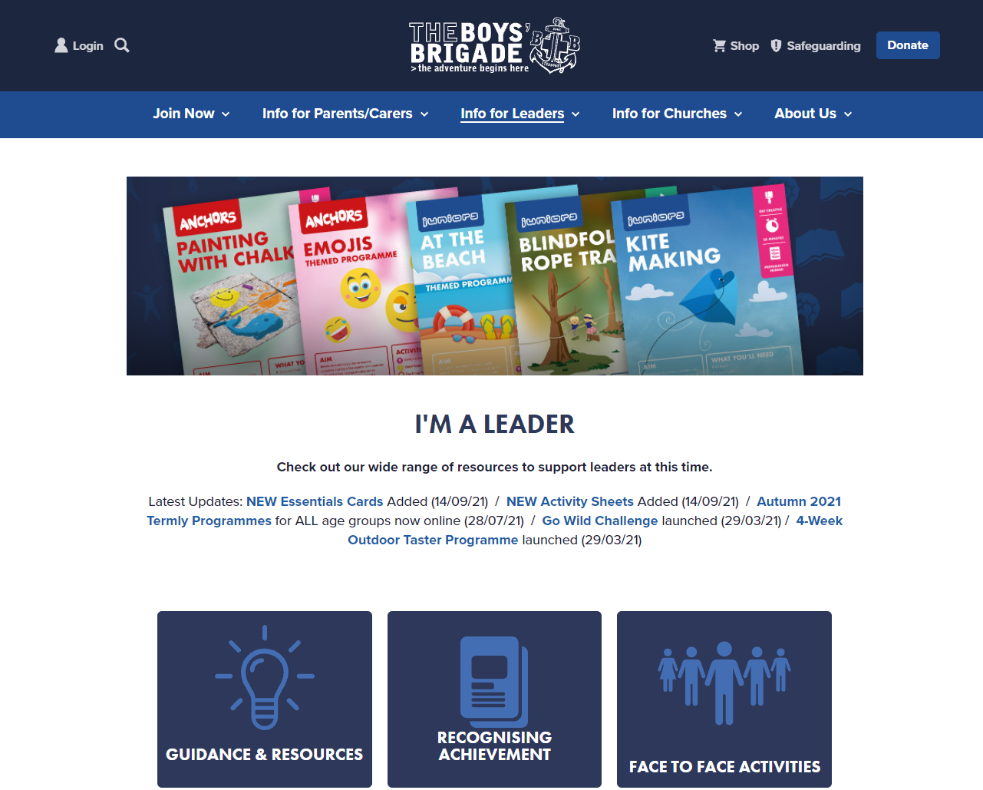
ACCESSING PROGRAMME RESOURCES
You can access resources at:
Programme Hub boys-brigade.org.uk/programme/
Online Brigade Manager (OBM) obm.boys-brigade.org.uk
WEBSITE: Let’s take a walk through these resources

Slide 7
THE PROGRAMMES
SMALL GROUP ACTIVITY: The Programmes – What do we think?
What do you particularly like about the programme?
Do the resources give you the confidence to deliver the programme? And if so, how…
Why do we have awards and why are they important?

Slide 8
DELIVERING A QUALITY PROGRAMME
Let’s look at how we plan and deliver a quality programme . . .
WHOLE GROUP: What are we looking for in our programmes?

Slide 9
WHAT ARE WE LOOKING FOR IN OUR PROGRAMMES?

Slide 10
DELIVERING A QUALITY PROGRAMME
Let’s look at how we plan and deliver a quality programme . . .
WATCH: Delivering a Quality Programme

Slide 12
DELIVERING A QUALITY PROGRAMME
Key aspects of delivery: - Accessibility - Progression - Voice (Youth Shaped)
SMALL GROUP ACTIVITY: Key aspects of delivery

Slide 13
PROGRAMME PLANNING
To deliver a quality programme we need to plan:
Annually
Termly
Weekly

Slide 14
ANNUALLY
TERMLY
WEEKLY

Slide 15
PROGRAMME PLANNING
Now we have had a look at what we need to consider Annually, Termly and Weekly, we’re going to plan an individual Weekly Meeting.
SMALL GROUP ACTIVITY: Plan a Term and one detailed Weekly Meeting
(split into age groups)

Slide 16
TYPICAL JUNIORS EVENING

Slide 17
PROGRAMME PLANNING
Now we have had a look at what we need to consider Annually, Termly and Weekly, we’re going to review a Termly Programme.
SMALL GROUP ACTIVITY: Reviewing Termly Programme (split into age groups)

Slide 18
PROGRAMME PLANNING
Now, let’s talk about the positives and negatives of the programmes we have looked at.
WATCH: Reviewing Termly Programme

Slide 19
SHARING PROGRAMME IDEAS
It’s now time for us to share some ideas and experiences. . .
SMALL GROUP ACTIVITY: Sharing Ideas

Slide 20
LEARNING OUTCOMES
At the end of this module, participants will be able to:
Understand more about the programmes for Under 11s and Over 11s.
Learn how to plan a balanced programme.
Feel confident in leading group activities.

