Slide 1
NOTES TO TRAINER
If you have not already downloaded and installed the Brigade fonts used in this presentation you can download our font pack at http://leaders.boys-brigade.org.uk/ourbrand.htm
Alternatively you may just need to check through the presentation to ensure the substitute font used is displaying correctly.
_________________________________________________________
This PowerPoint presentation may have videos embedded into it (these require a internet connection as are streamed from Vimeo), when you come to these click the play button to start the video. Ensure when sharing your screen through Zoom you tick the ‘Share Computer Sound’ box.

Slide 3
LEARNING OUTCOMES
At the end of this session participants will be able to:
Be able to create a safe environment.
Understand their role and responsibilities.
Be able to complete risk assessments and manage risk.
Be able to respond to an emergency including how to record/report.
Know where to access resources and guidance.

Slide 4
E-LEARNING RECAP
Who is responsible for managing risk and providing a safe environment for children & young people?
When do we need to assess risk?
What steps do we take in assessing risk?
Who is responsible for putting together a risk assessment?
In a risk assessment who do we consider might be harmed?
When should a risk assessment be reviewed?
How do we respond to an emergency?
How do we record & reporting accidents/incidents?

Slide 5
ASSESSING RISKS
Typical BB activities:
Company Football Training
Anchors Crafts
Seniors Drama
Anchors Indoor Games
Company Orienteering
Seniors Night Out
Juniors Cooking
Juniors Visit
Company Model Making
Juniors Swimming Trip
SMALL GROUP ACTIVITY: Completing a Risk Assessment
In carrying out a risk assessment we need to be:
Identifying & locating hazards
Considering who might be harmed and how
Identifying how risks are controlled
Select a typical BB activity from the list (to the right) to base your risk assessment on.

Slide 6
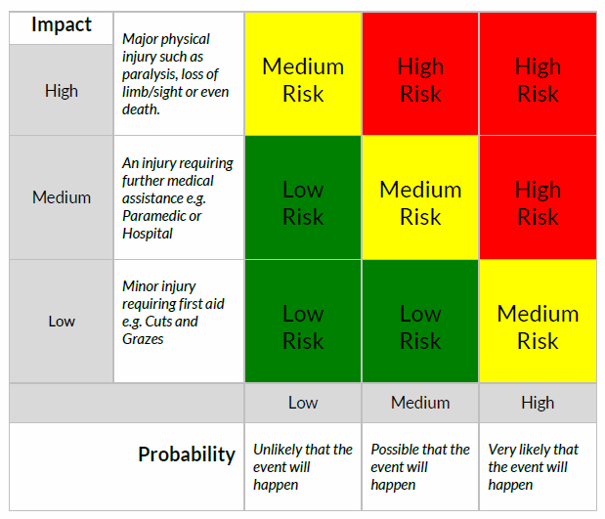
RISK v BENEFIT ANALYSIS
Where would you place the activities?

Slide 7
LEARNING OUTCOMES
At the end of this session participants will be able to:
Be able to create a safe environment.
Understand their role and responsibilities.
Be able to complete risk assessments and manage risk.
Be able to respond to an emergency including how to record/report.
Know where to access resources and guidance.
You can always find guidance and resources at BOYS-BRIGADE.ORG.UK/MANAGING-RISK/

