Slide 1
NOTES TO TRAINER
If you have not already downloaded and installed the Brigade fonts used in this presentation you can download our font pack at https://boys-brigade.org.uk/our-brand/
Alternatively you may just need to check through the presentation to ensure the substitute font used is displaying correctly.
_________________________________________________________
This PowerPoint presentation may have videos embedded into it (these require a internet connection as are streamed from Vimeo), when you come to these click the play button to start the video. Ensure when sharing your screen through Zoom you tick the ‘Share Computer Sound’ box.

Slide 3
AIM
To equip BB leaders with the skills, knowledge and understanding to plan and lead residential activities with children and young people.

Slide 4
LEARNING OUTCOMES
At the end of this training, participants will be able to:
Identify the key elements in the preparation phase of a residential.
Set realistic aims for the event in consultation with children and young people.
Plan and deliver a high-quality programme at a residential.
Carry out effective risk assessments for residentials.
Understand the importance of maintaining professional boundaries during settings such as residentials, events, and activities outside of BB weekly sessions.

Slide 5
LEARNING OUTCOMES
At the end of this training, participants will be able to:
Recognise the importance of maintaining safe and appropriate boundaries with children and young people during residentials.
Understand and meet the needs of children and young people away from home.
Contribute to positive working relationships with adult colleagues.
Identify ways to support children and young people on their faith journey.

Slide 7
LEARNING OUTCOMES
By the end of this module, participants will be able to:
Identify the key elements of preparing for any residential.
Understand how to notify a residential through OBM.
Feel confident in leading a residential.

Slide 8
WHY RESIDENTIALS?
What are we trying to achieve through going on a residential activity and what benefits are achieved?
SMALL GROUP ACTIVITY: Why Residentials?

Slide 10
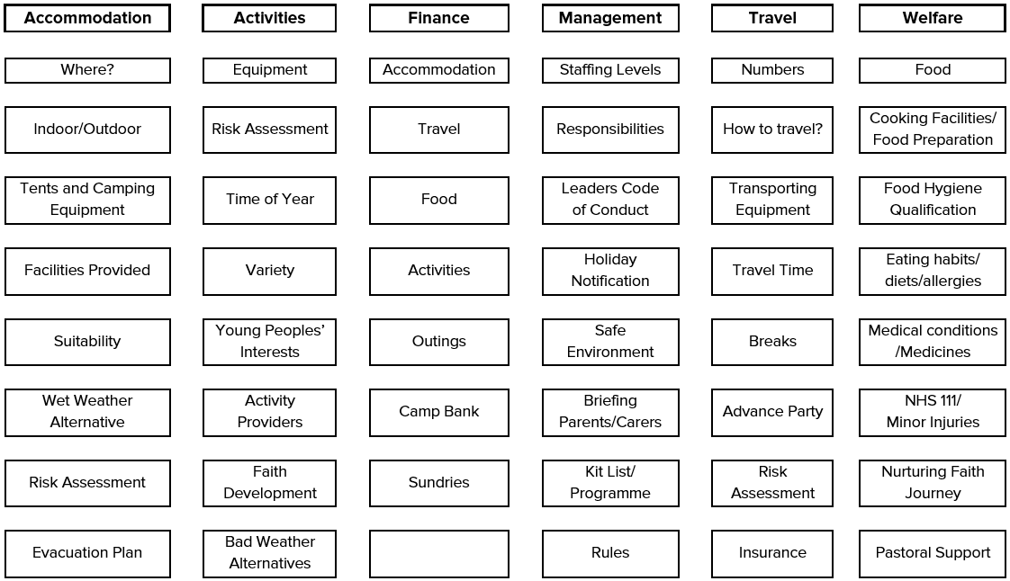
PLANNING A SUCCESSFUL RESIDENTIAL

Slide 11
CAMP, HOLIDAY AND EXPEDITION NOTIFICATIONS
Find out more at https://boys-brigade.org.uk/camp-holiday-and-expedition-notifications

Slide 12
LEARNING OUTCOMES
By the end of this module, participants will be able to:
Identify the key elements of preparing for any residential.
Understand how to notify a residential through OBM.
Feel confident in leading a residential.

Slide 14
LEARNING OUTCOMES
By the end of this module, participants will be able to:
Plan and deliver a high quality programme at a residential.
Consider ways to adapt the programme to be accessible for all.

Slide 15
PROGRAMME PLANNING
Come up with the essential points in planning an effective programme.
WHOLE GROUP ACTIVITY: Basic Principles for Successful Planning

Slide 16
FAITH DEVELOPMENT ON A RESIDENTIAL
Divide into smaller groups and discuss the following questions:
Why do we think residentials can be so significant in a young person's faith journey?
What does this look like within the programme for your residential?
Who will be involved in supporting this?
WHOLE GROUP ACTIVITY: Faith Development on a Residential

Slide 17
PLANNING A PROGRAMME
In groups, plan a week/weekend programme for one of the following scenarios:
Group 1: An overnight sleepover in the Church hall for Juniors
Group 2: A week’s camping for Company & Seniors age group
Group 3: A long weekend at an indoor centre for Juniors
Group 4: A five-day international trip to a European city for Seniors
SMALL GROUP ACTIVITY: Planning a Programme

Slide 18
LEARNING OUTCOMES
By the end of this module, participants will be able to:
Plan and deliver a high quality programme at a residential.
Consider ways to adapt the programme to be accessible for all.

Slide 20
LEARNING OUTCOMES
By the end of this module, participants will be able to:
Carry out an effective high level risk assessment for residentials.

Slide 21
FIVE STEPS TO ASSESSING RISK
Identifying and locating hazards
Considering who might be harmed and how
Identifying how risks are controlled
Recording and communicating risks and control measures
Reviewing and updating as necessary

Slide 22
COMPLETING A RISK ASSESSMENT
In groups, consider the residential scenario you looked at in Programme Planning and spend 10 minutes completing a high level risk assessment - to include:
The areas under consideration e.g. accommodation, travel, etc.
Identifying and locating hazards
Considering who might be harmed and how
Identifying how risks are controlled
Group 1: An overnight sleepover in the Church hall for Juniors
Group 2: A week’s camping for Company & Seniors age group
Group 3: A long weekend at an indoor centre for Juniors
Group 4: A five-day international trip to a European city for Seniors
SMALL GROUP ACTIVITY: Completing a Risk Assessment

Slide 23
LEARNING OUTCOMES
By the end of this module, participants will be able to:
Carry out an effective high level risk assessment for residentials.

Slide 25
LEARNING OUTCOMES
By the end of this module, participants will be able to:
Understand the importance of maintaining professional boundaries during settings such as residentials, events, and activities outside of BB weekly sessions.
Recognise the importance of maintaining safe and appropriate boundaries with children and young people during residentials.

Slide 26
BEHAVIOURS AND BLURRED BOUNDARIES
In groups, consider behaviours of a leader before, during and after a residential that could cause inappropriate boundaries with young people developing.
SMALL GROUP ACTIVITY: Behaviours and Blurred Boundaries

Slide 27
LEADERS CODE OF CONDUCT
The Leaders Code of Conduct provides guidance to help support leaders maintain healthy relationships and appropriate boundaries within the BB.
https://boys-brigade.org.uk/leaders-code-of-conduct

Slide 28
BOUNDARIES – MAKING IT SAFER FOR ALL
In groups, consider things that would make a residential settings safer for all.
SMALL GROUP ACTIVITY: Making Residential Settings Safer for All

Slide 29
LEARNING OUTCOMES
By the end of this module, participants will be able to:
Understand the importance of maintaining professional boundaries during settings such as residentials, events, and activities outside of BB weekly sessions.
Recognise the importance of maintaining safe and appropriate boundaries with children and young people during residentials.

Slide 31
LEARNING OUTCOMES
By the end of this module, participants will be able to:
Understand and meet the needs of children and young people away from home.
Understand the roles and responsibilities of leaders on a residential.
Understand how sharing the workload amongst team members can reduce conflict.
Identify ways to support children, young people and leaders on their faith journey.

Slide 32
PHYSICAL & EMOTIONAL NEEDS
Physical
Emotional

Slide 33
Residential Leader-in-Charge
Cook/Catering Assistant
First Aider
Programme & Sports Lead
Spiritual/Faith lead
Duty Leader/Duty Team
Someone in charge of campsite
Residential Activity Helper
BUILDING RELATIONSHIPS
In groups, consider the roles and responsibilities for each role identified and any additional tasks they should undertake.
SMALL GROUP ACTIVITY: Roles & Responsibilities

Slide 34
RESIDENTIAL CASE STUDIES
In groups, work through case studies. Each group starts with a different study:
Group 1 start with Scenario A: Homesick
Group 2 start with Scenario B: Self-harm
Group 3 start with Scenario C: New Young Leader
Group 4 start with Scenario D: Eating Likes & Dislikes
SMALL GROUP ACTIVITY: Case Studies

Slide 35
LEARNING OUTCOMES
By the end of this module, participants will be able to:
Understand and meet the needs of children and young people away from home.
Understand the roles and responsibilities of leaders on a residential.
Understand how sharing the workload amongst team members can reduce conflict.
Identify ways to support children, young people and leaders on their faith journey.

Slide 37
LEARNING OUTCOMES
At the end of this training, participants will be able to:
Identify the key elements in the preparation phase of a residential.
Set realistic aims for the event in consultation with children and young people.
Plan and deliver a high-quality programme at a residential.
Carry out effective risk assessments for residentials.
Understand the importance of maintaining professional boundaries during settings such as residentials, events, and activities outside of BB weekly sessions.

Slide 38
LEARNING OUTCOMES
At the end of this training, participants will be able to:
Recognise the importance of maintaining safe and appropriate boundaries with children and young people during residentials.
Understand and meet the needs of children and young people away from home.
Contribute to positive working relationships with adult colleagues.
Identify ways to support children and young people on their faith journey.

Slide 39
Q&A
Do you have any questions, either relating to the training today or about residentials in general?

